Slide 1
Republic of Georgia
Since 1991 no Soviet Republic

Slide 2
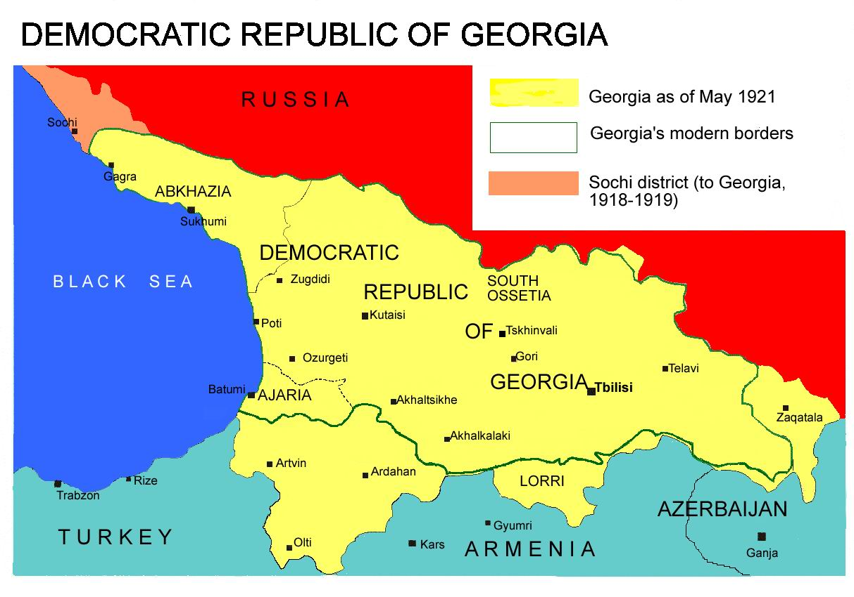

Slide 3
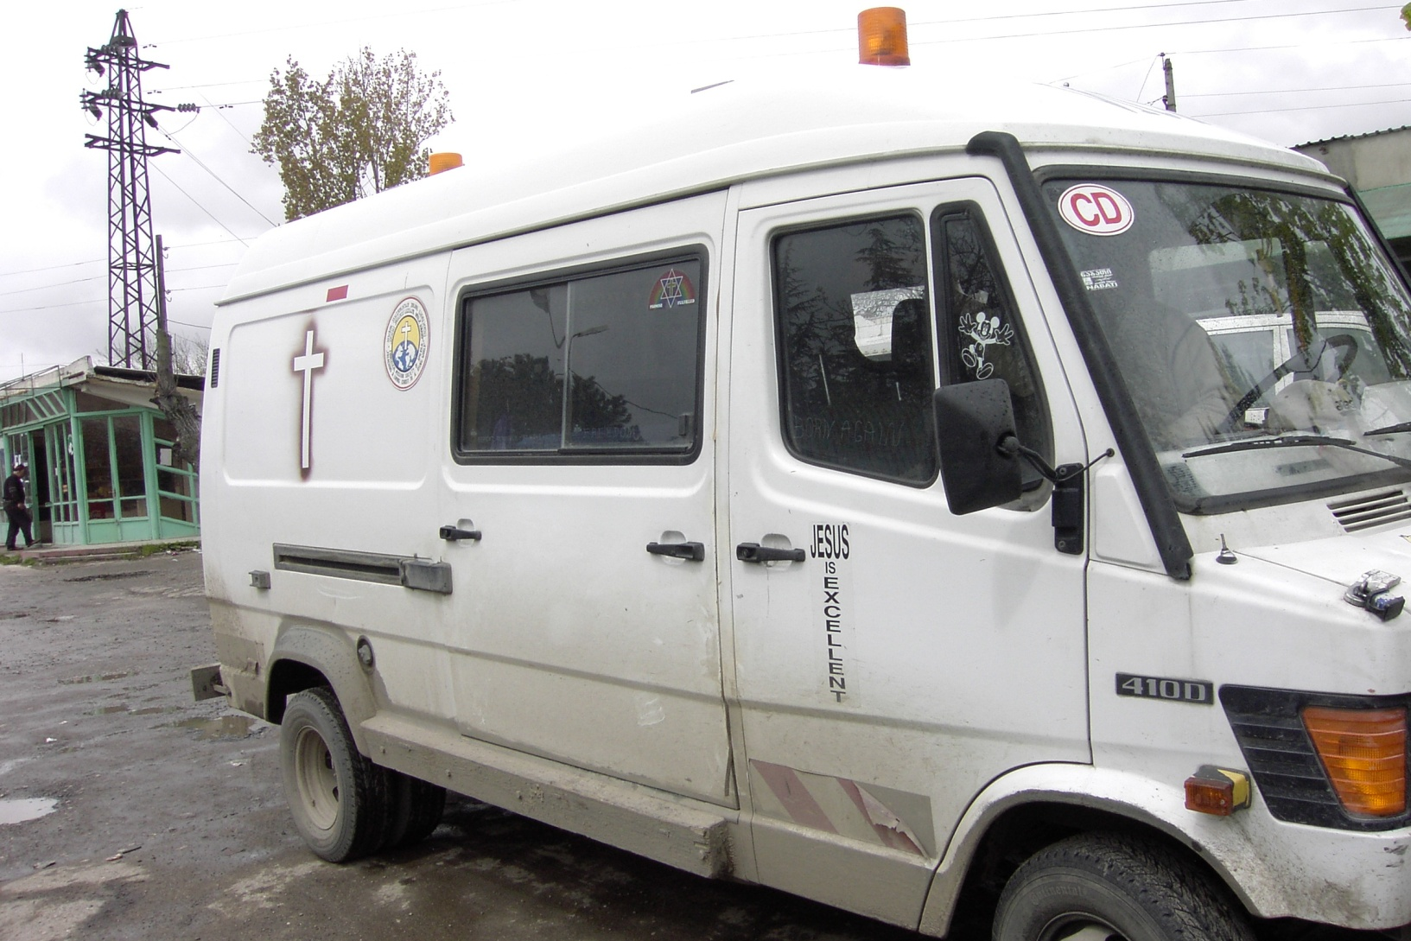
And Steve’s transportation to

Slide 4
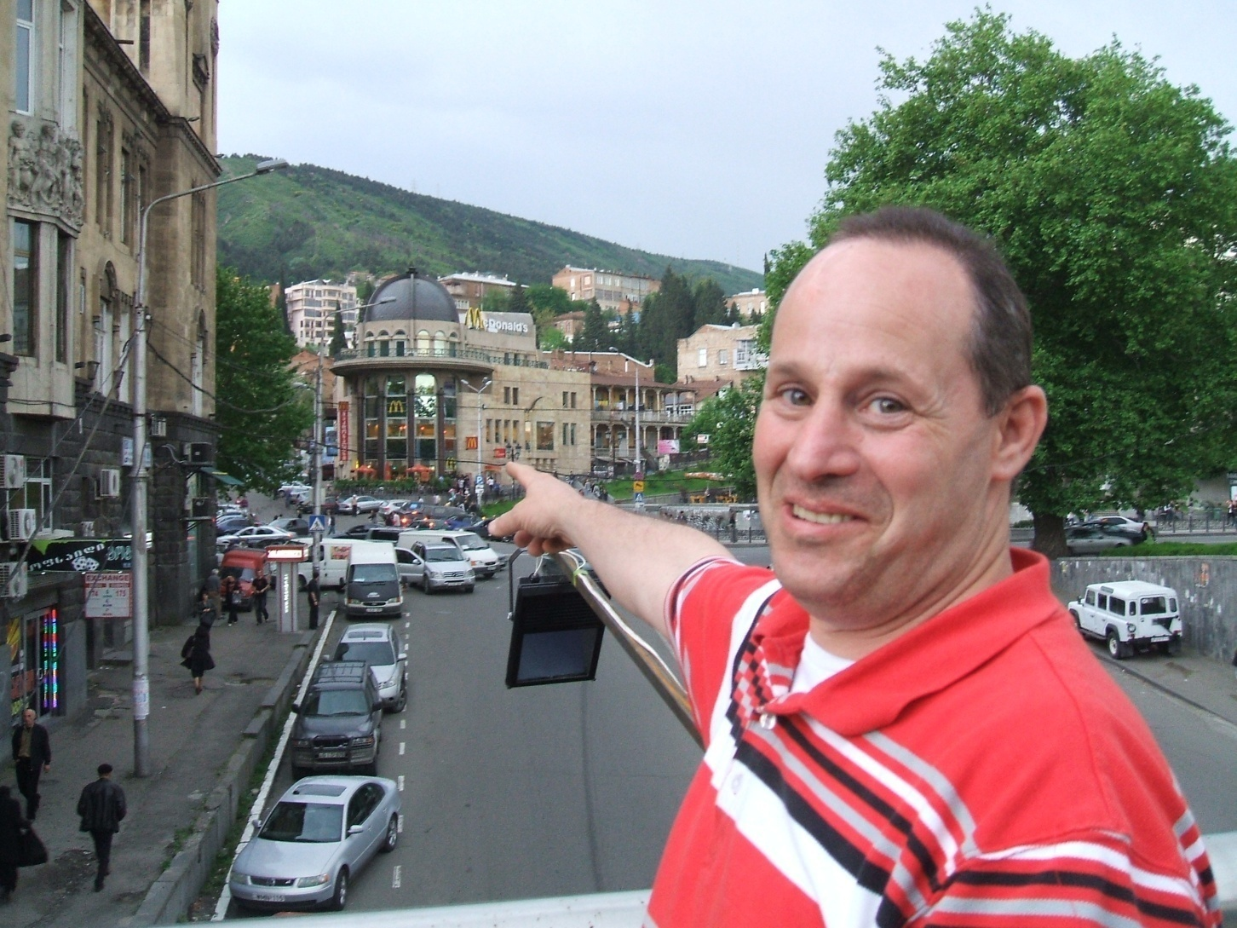
Tbilisi, the capital, there is a Mc Donald

Slide 5
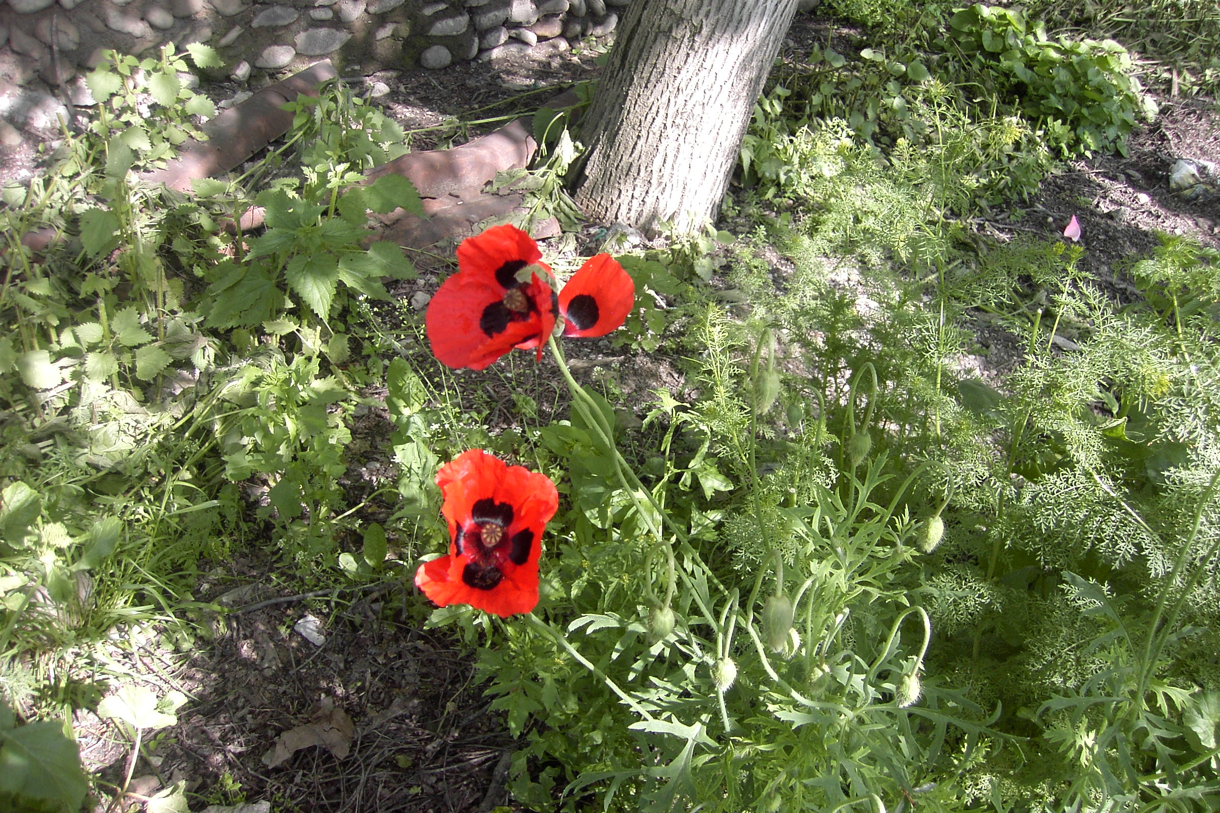
Georgia is simple, beautiful

Slide 6
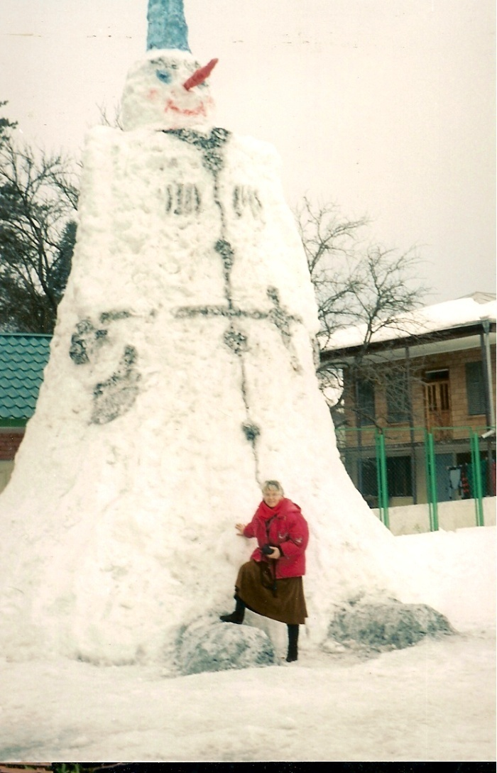
Sometimes it can be cold.

Slide 7
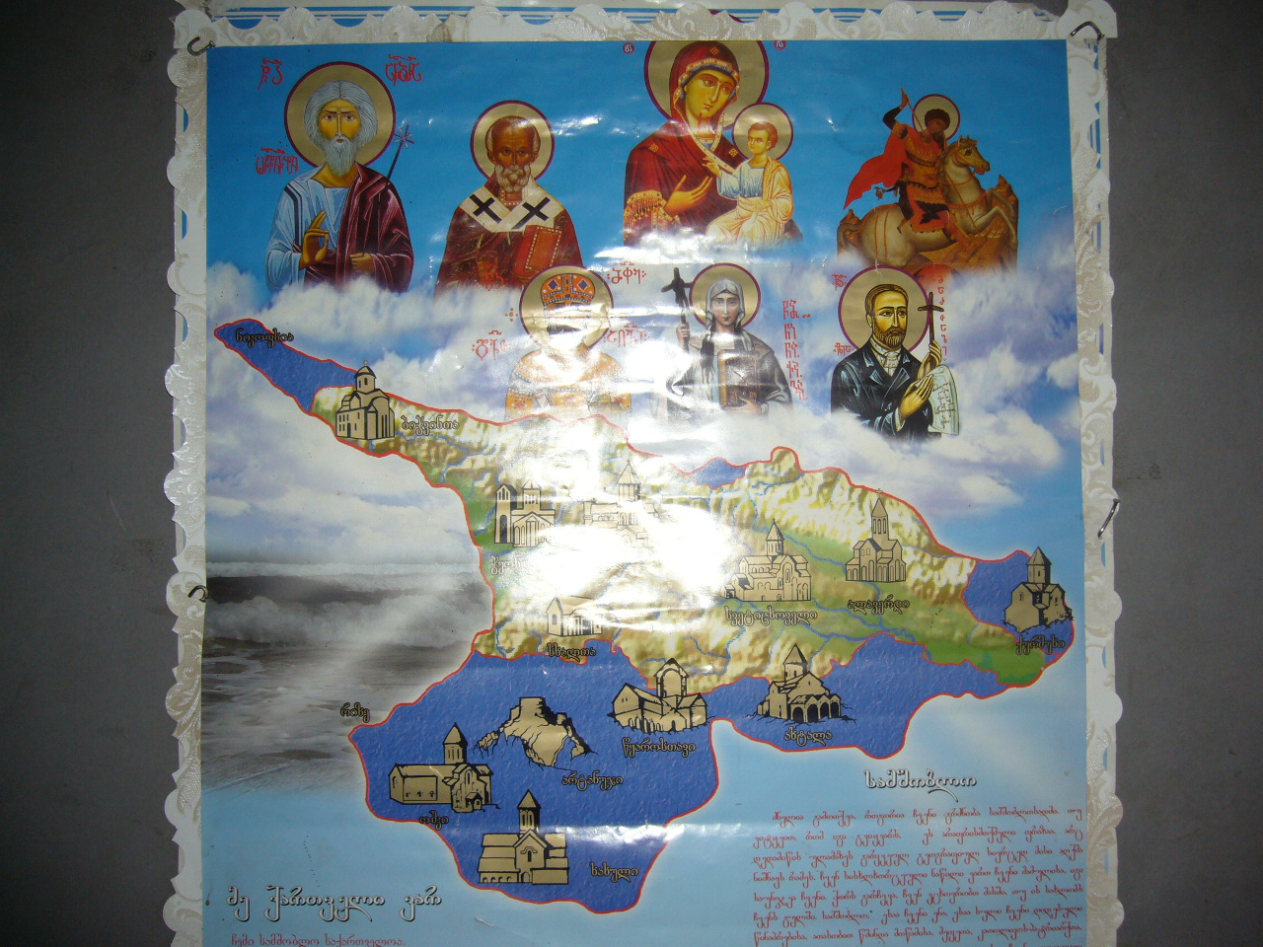
Georgia is 60 % Orthodox

Slide 8
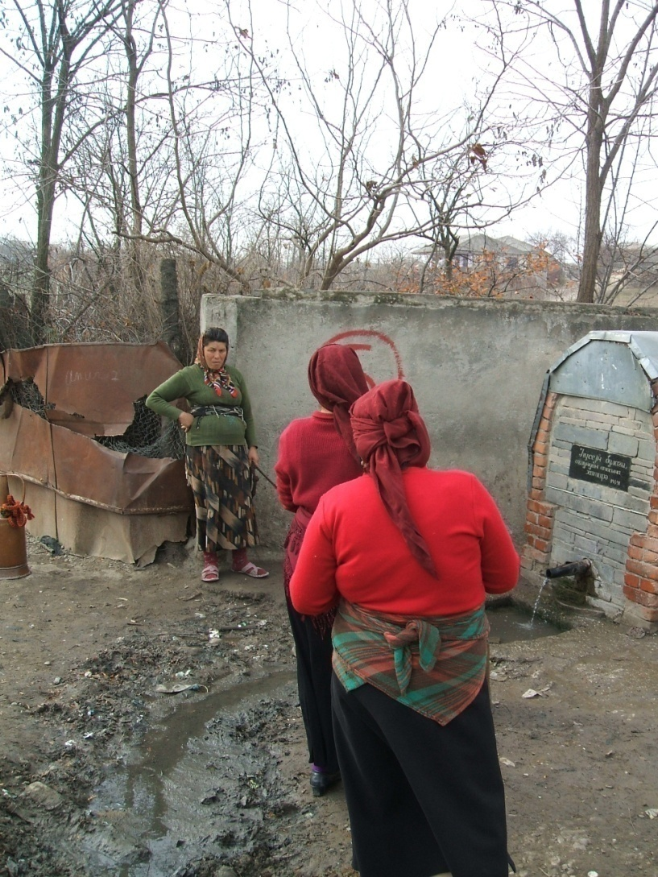
Villages are poor.

Slide 9
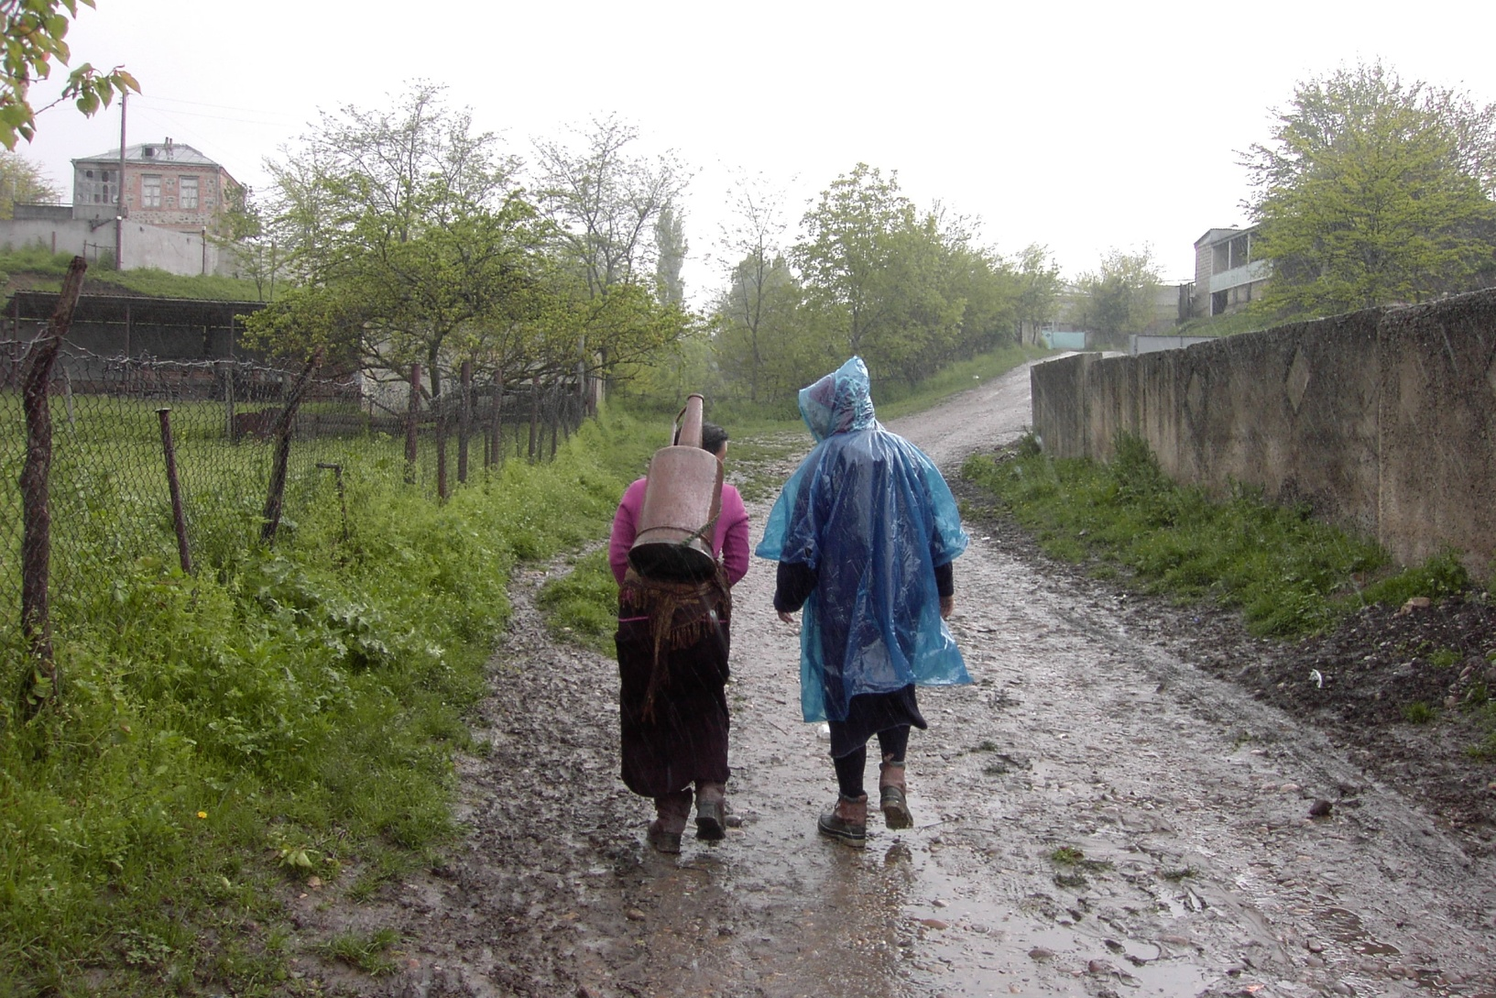
Women carry daily drinking water.

Slide 10
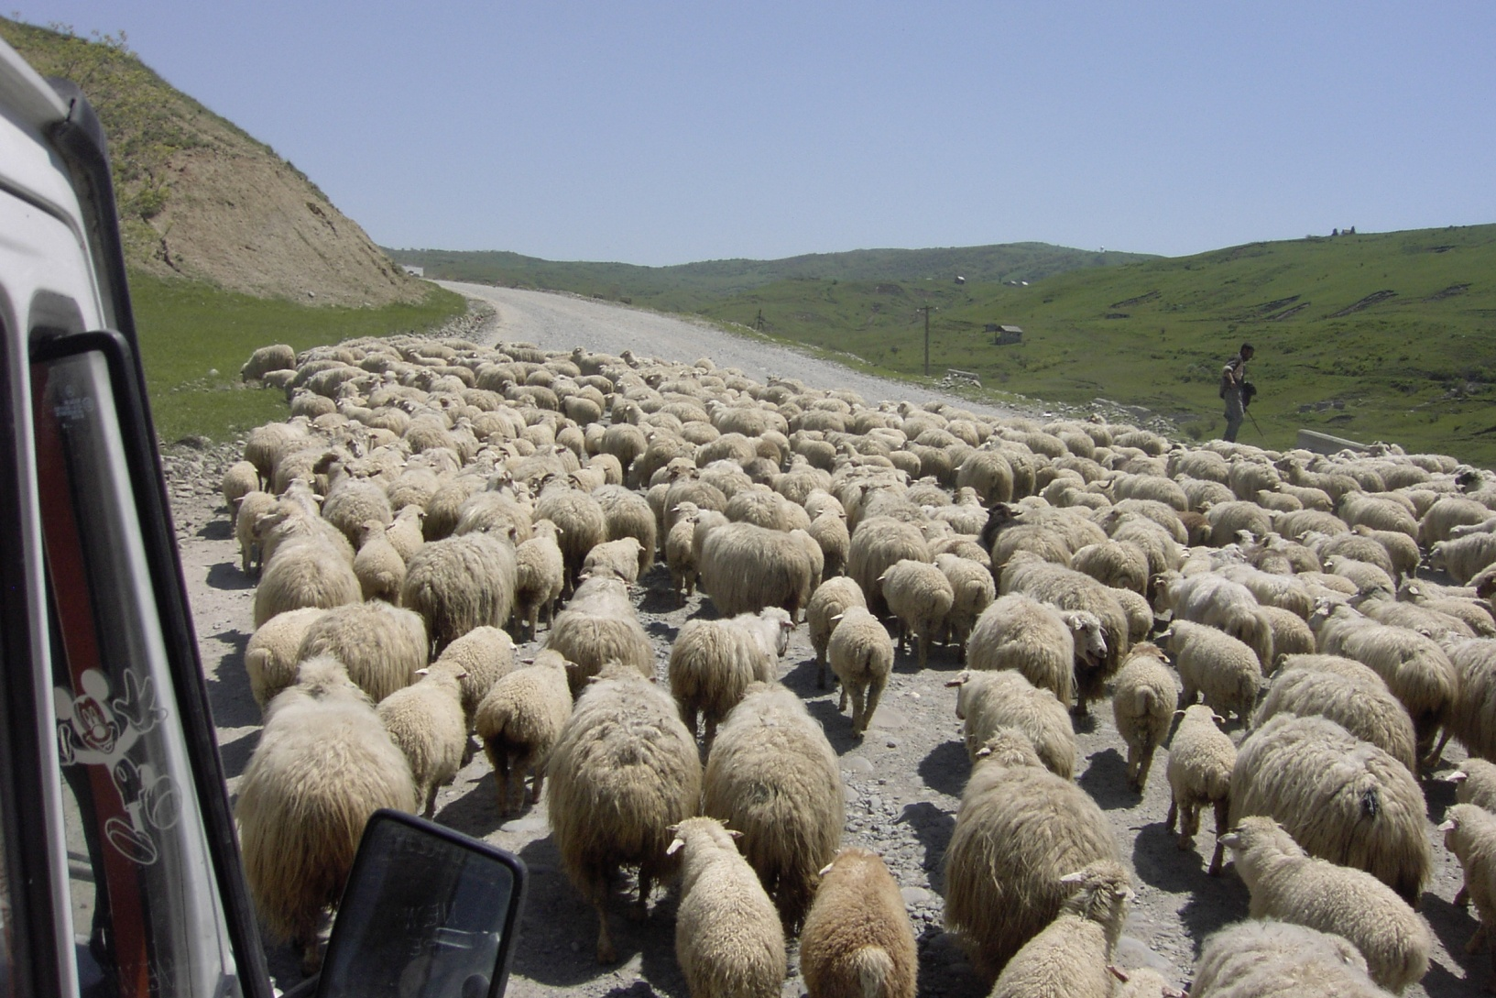
Spiritually, most are lost like sheep without a shepherd.

Slide 11
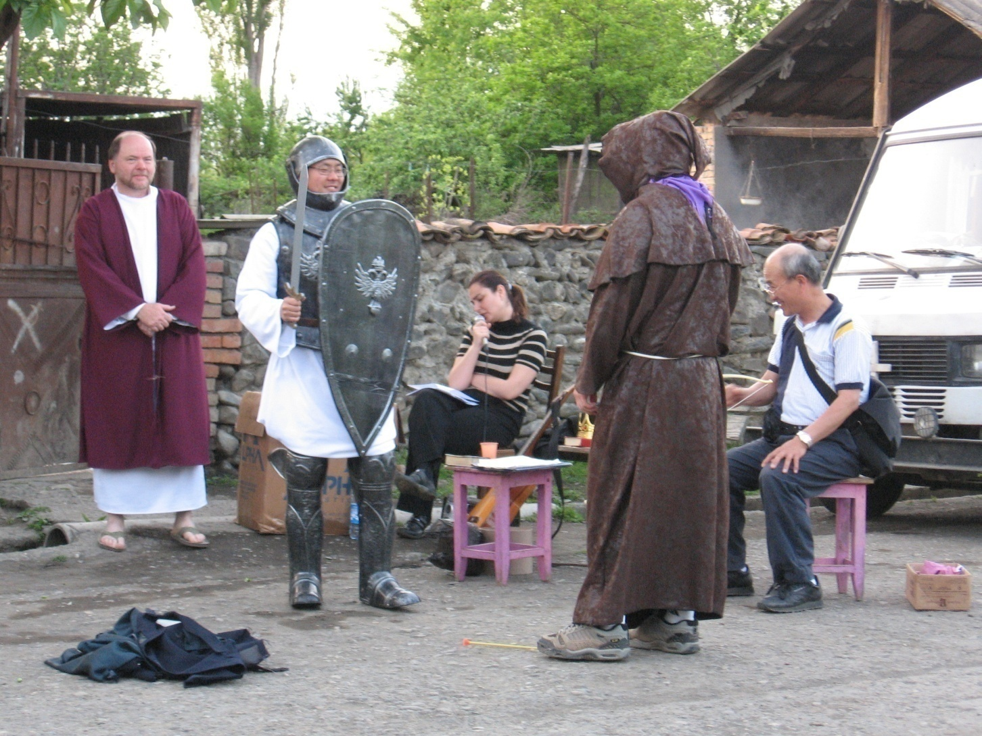
So EMSA helps pastors through witnessing by street theater.

Slide 12
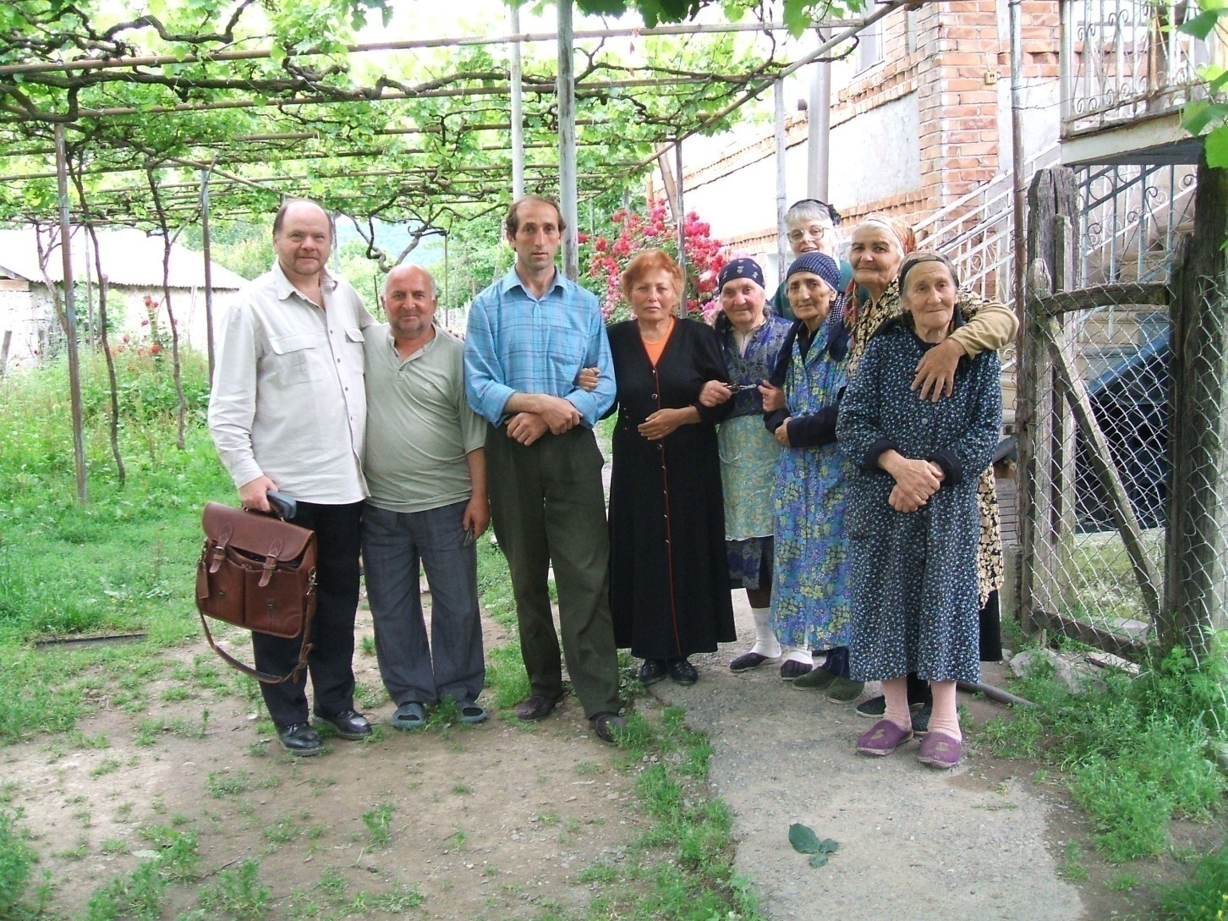
Visiting them in helping their missionary teams
East Georgia

Slide 13
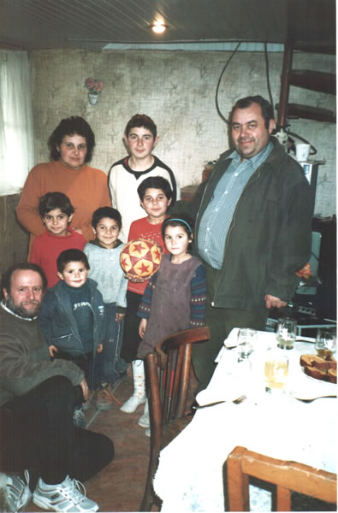
Misha, pastor in Gori, after the war with wife and 6 children.

Slide 14
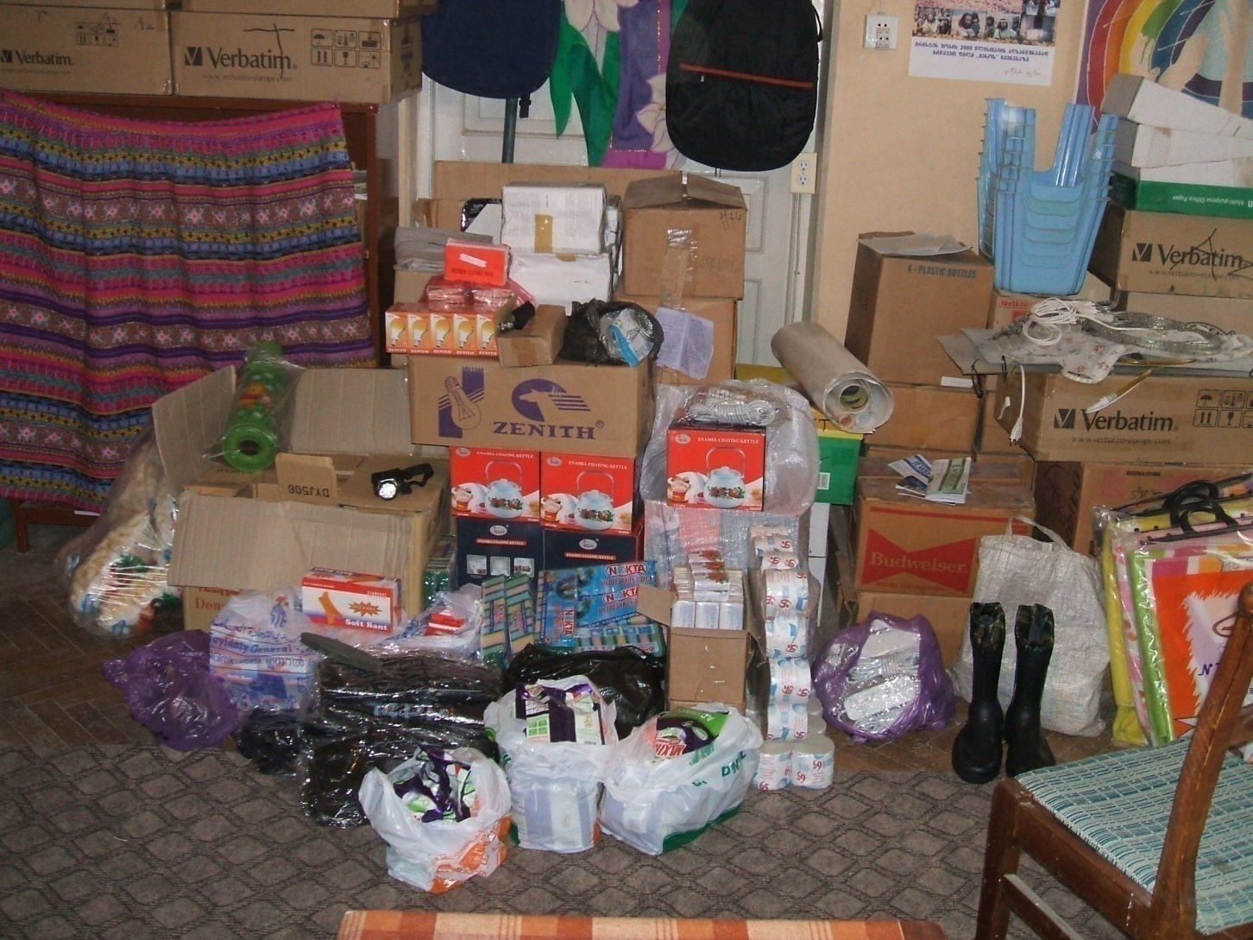
received food supply for his church.

Slide 15
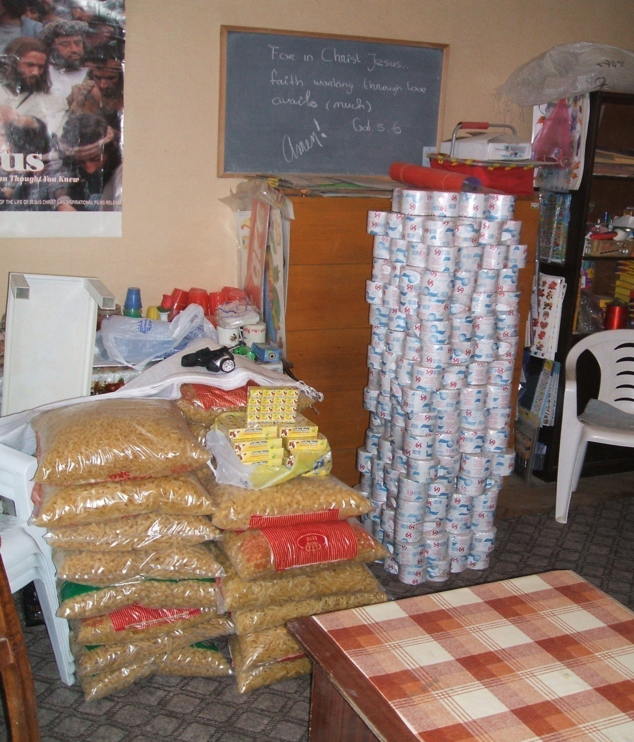
Since 1999 we transported aid to many poor village pastors with the help of The Bridge International
Food
Useful tools
Bibles
Literature
Encouragement
Connections with others
Clothes
Medical kits
School kits
House items
Transportation means like

Slide 16
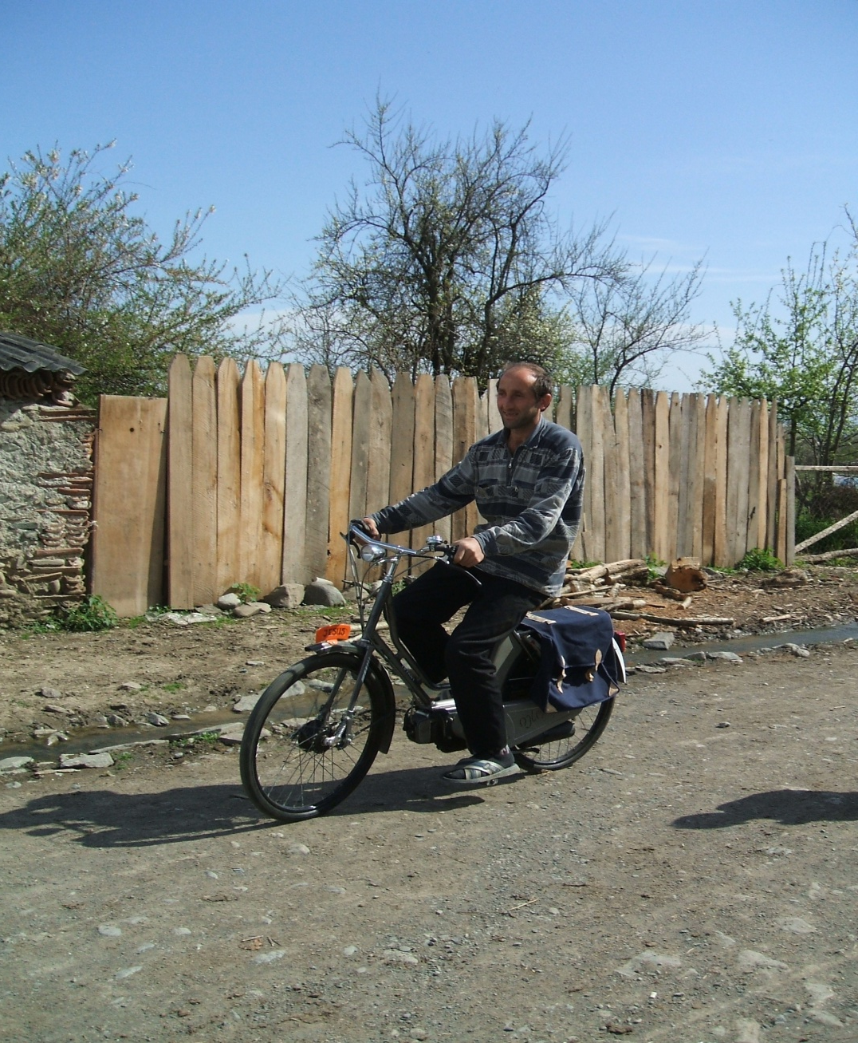
A new moped for assistant Pastor, Alani.

Slide 17
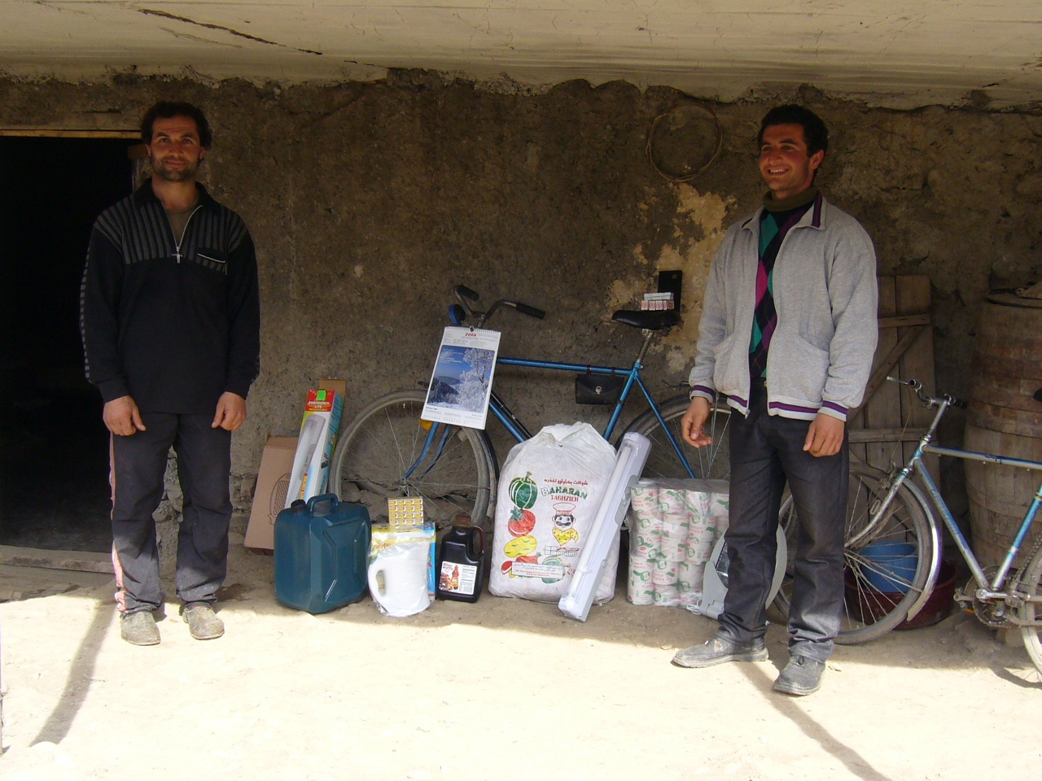
Food and bikes for Emzari and Zura

Slide 18
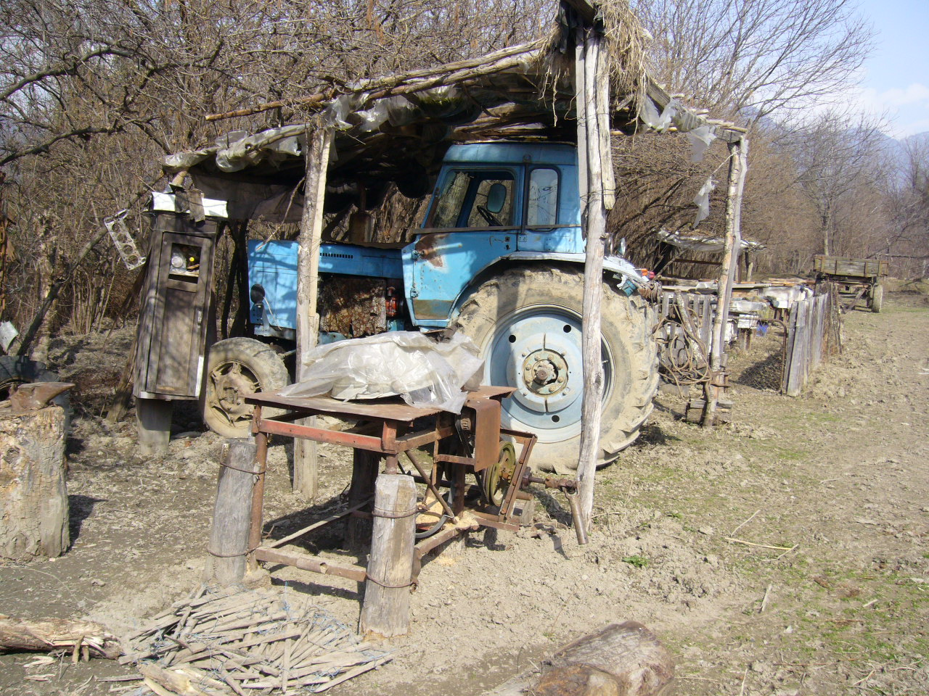
EMSA donated a tractor to Pavel, senior pastor, with 3 land working tools

Slide 19
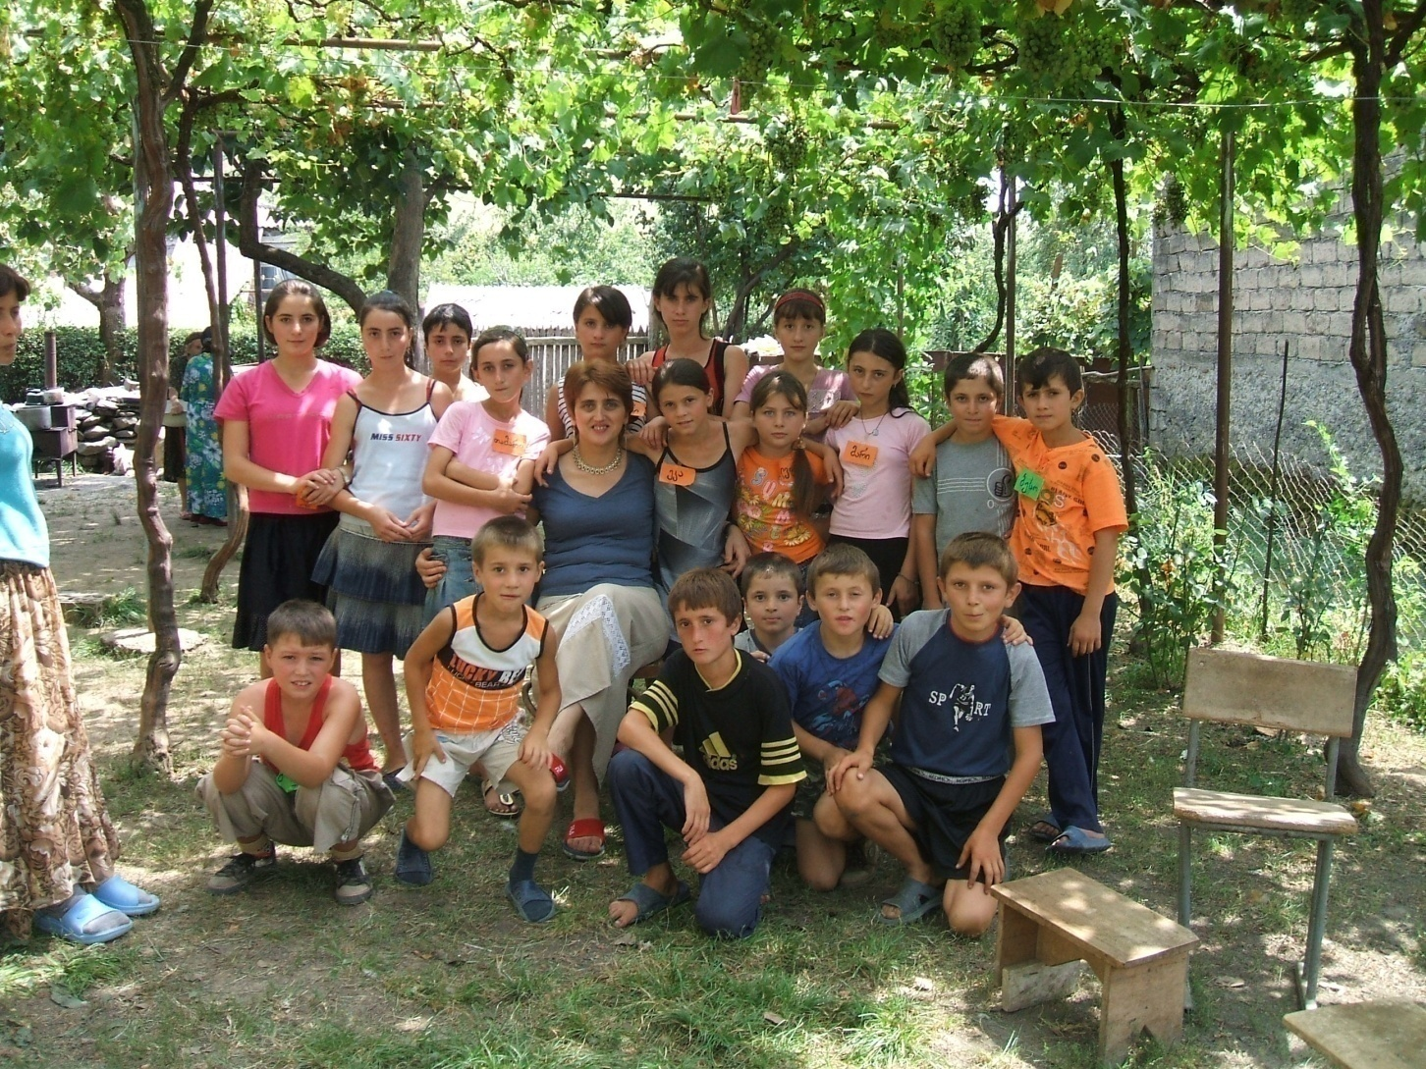
EMSA conducted a village VBS in 2008 for Ossetian, Georgian and Russian children close to the war zone.

Slide 20
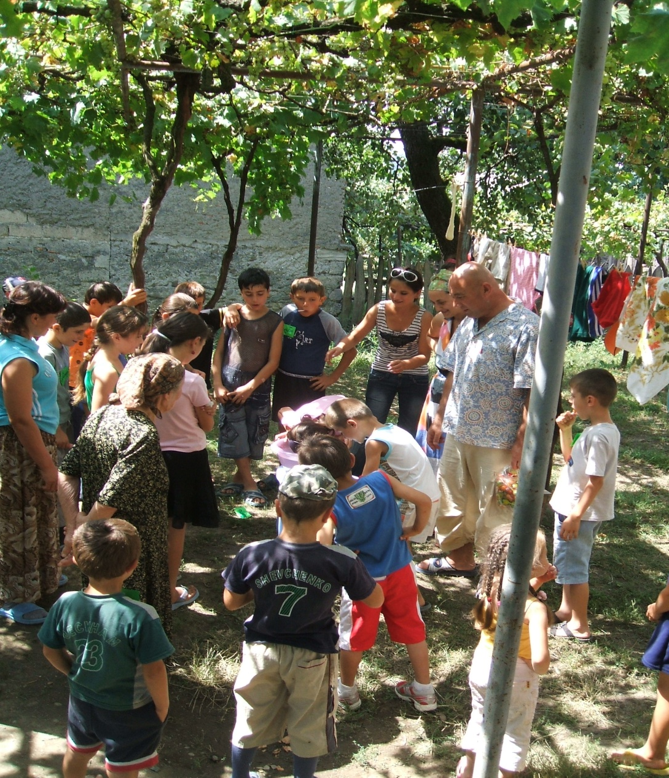
Many committed themselves to the Lordship of Jesus Christ .

Slide 21
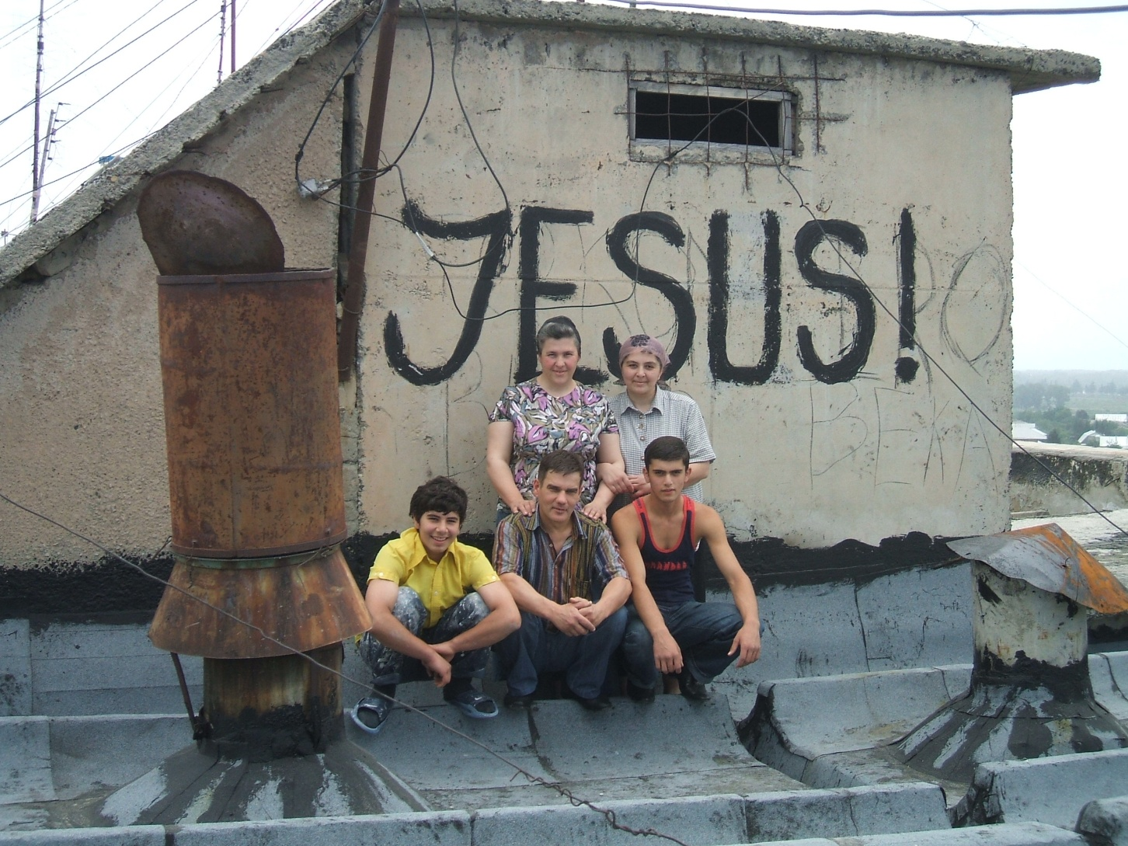
EMSA repaired the prayer house in Rustavi for a prayerful widow with 4 sons.

Slide 22
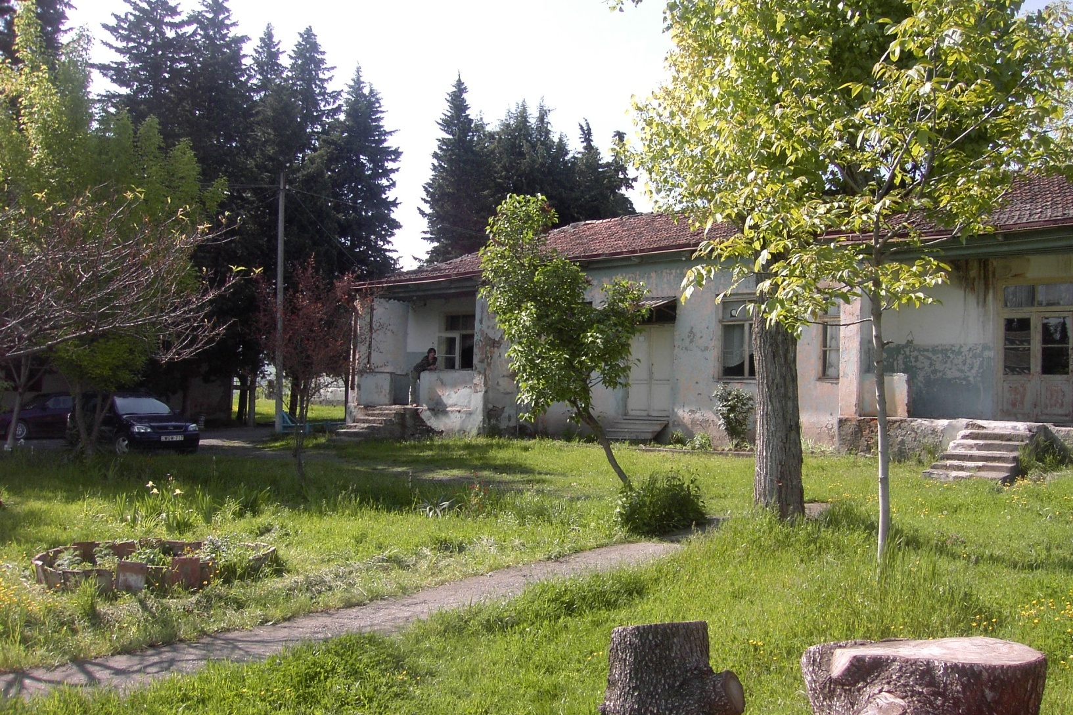
In Georgia are many orphanages.

Slide 23
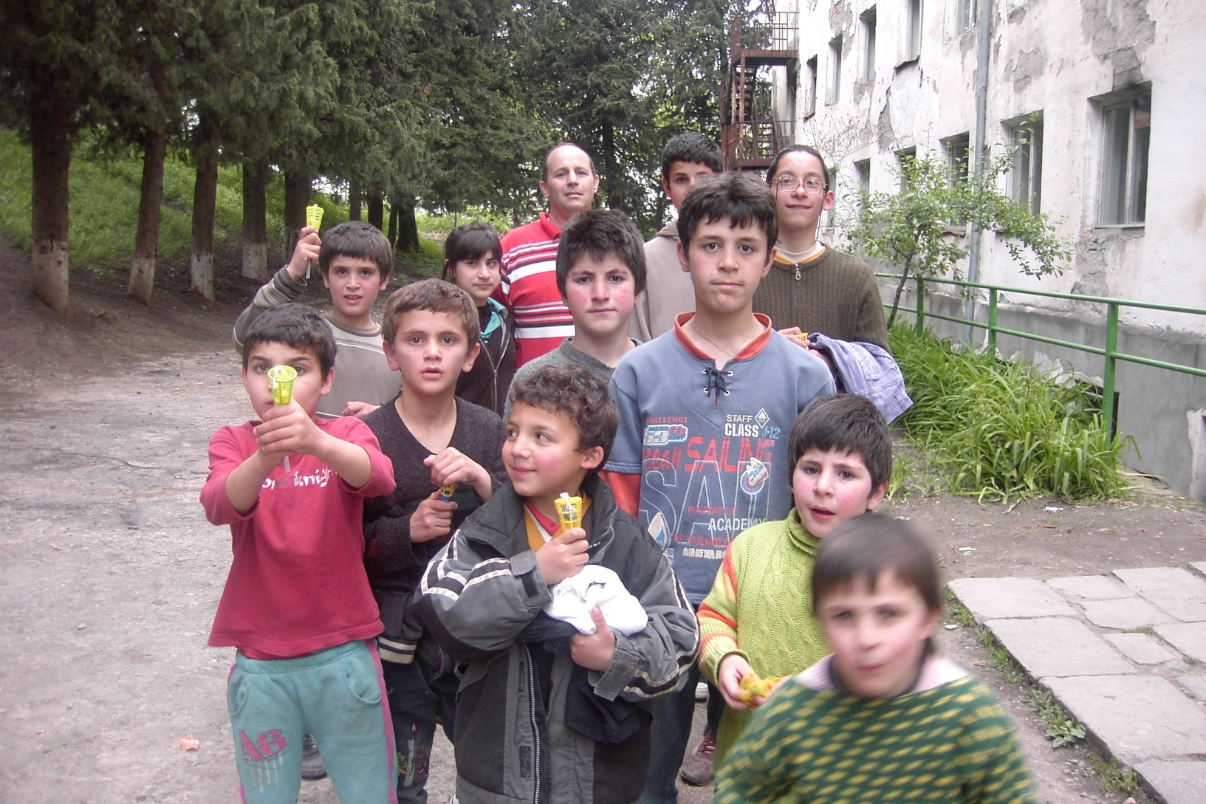
Where clothes and toys are needed.

Slide 24
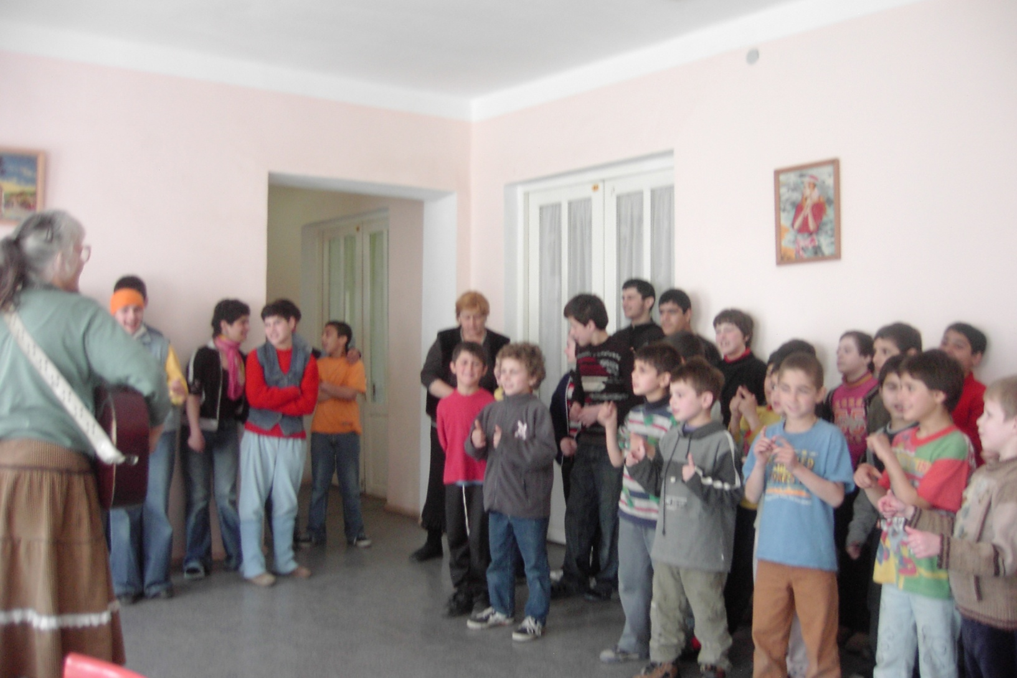
and hope

Slide 25
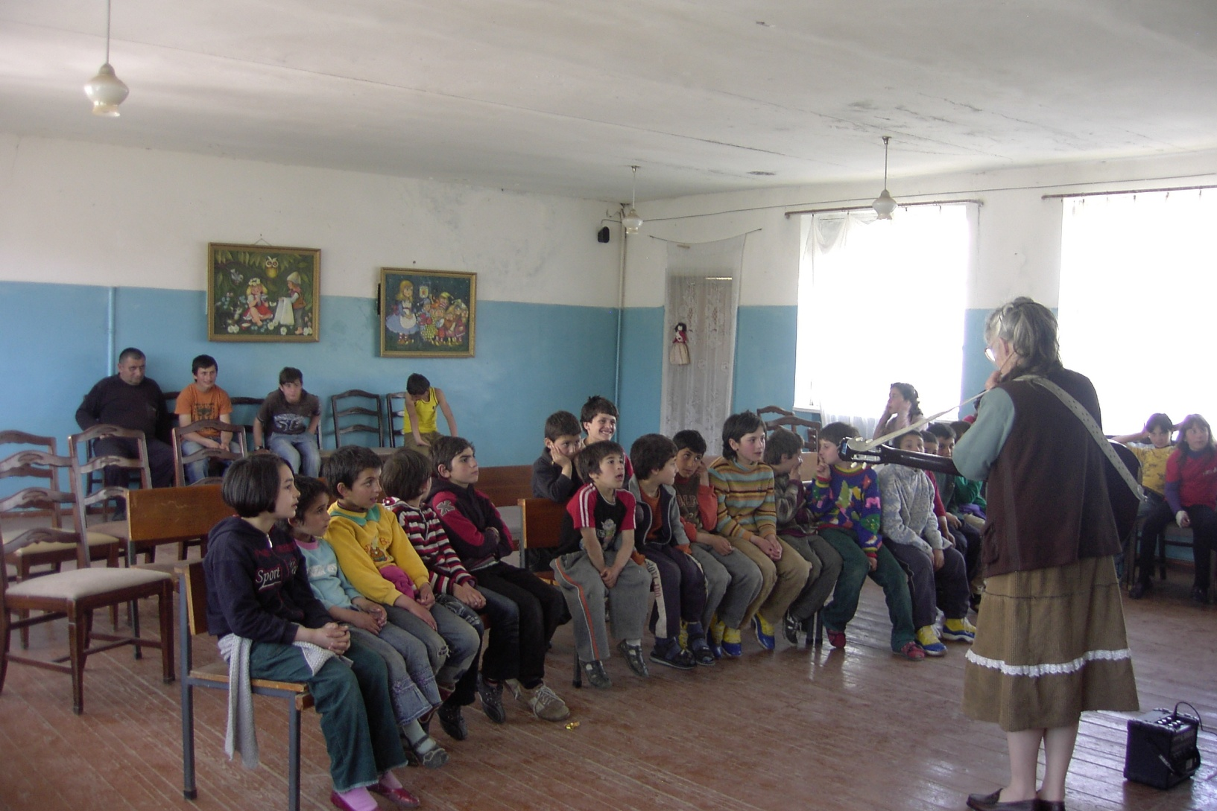
and Joy for today.

Slide 26
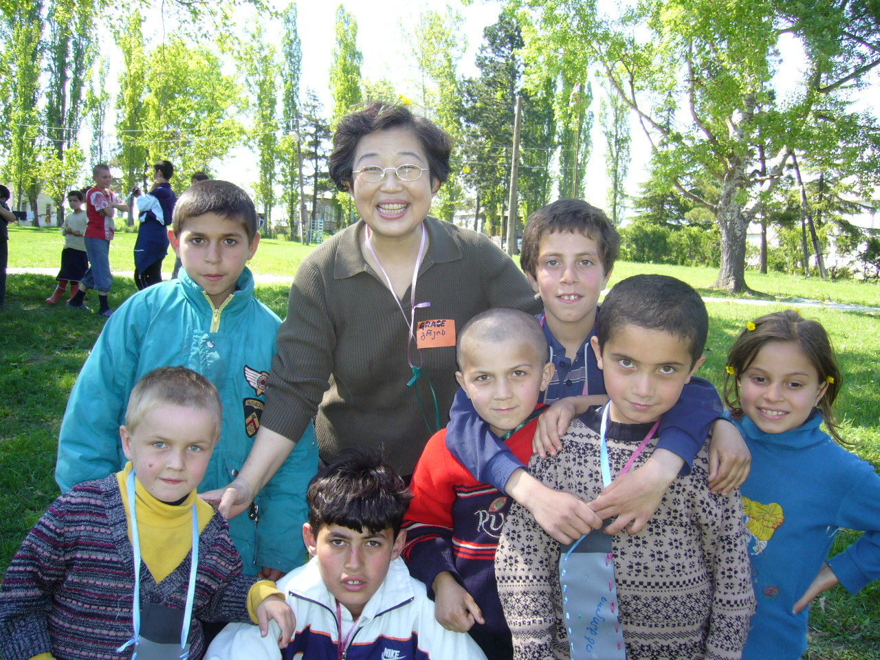
Friendship

Slide 27
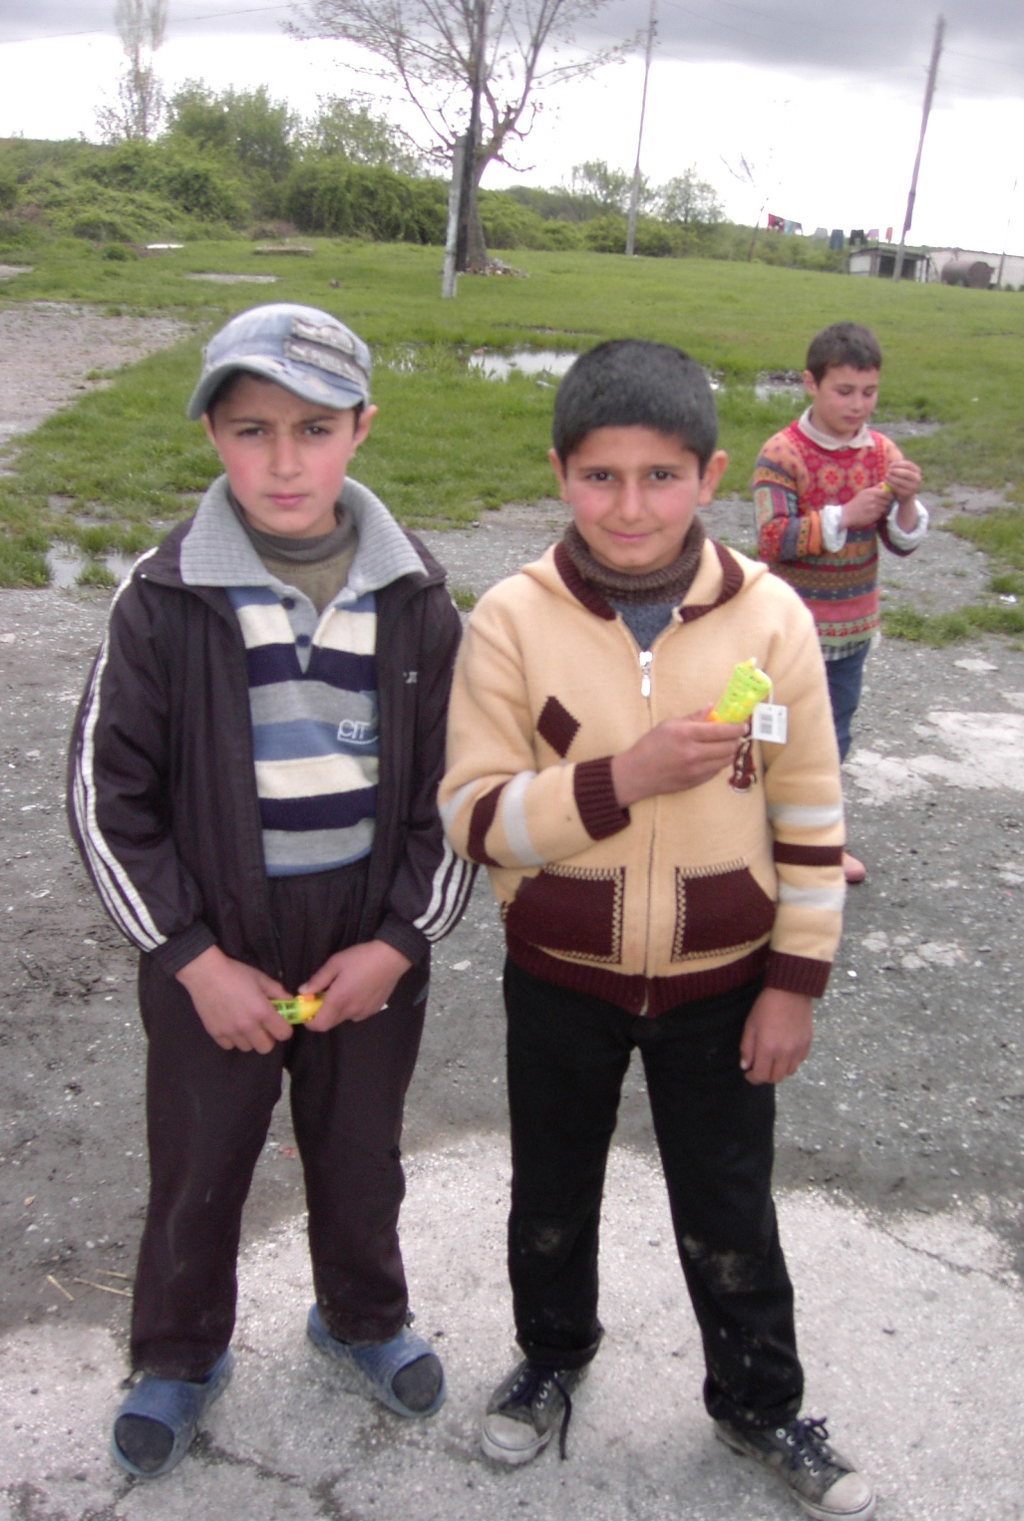
Love

Slide 28
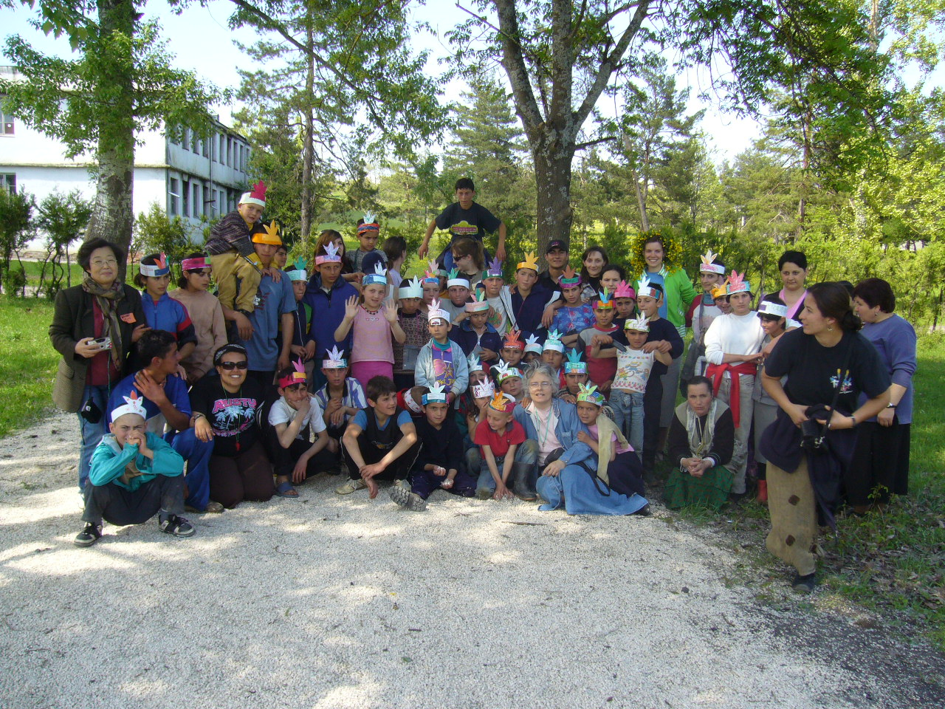
VBS “If you want to grow”

Slide 29
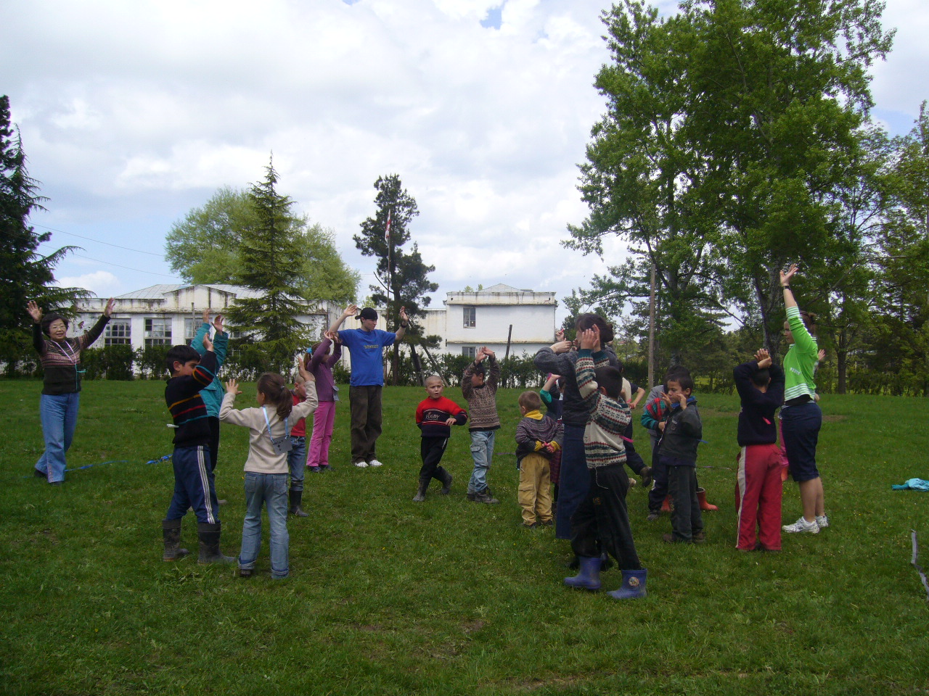
Sports

Slide 30
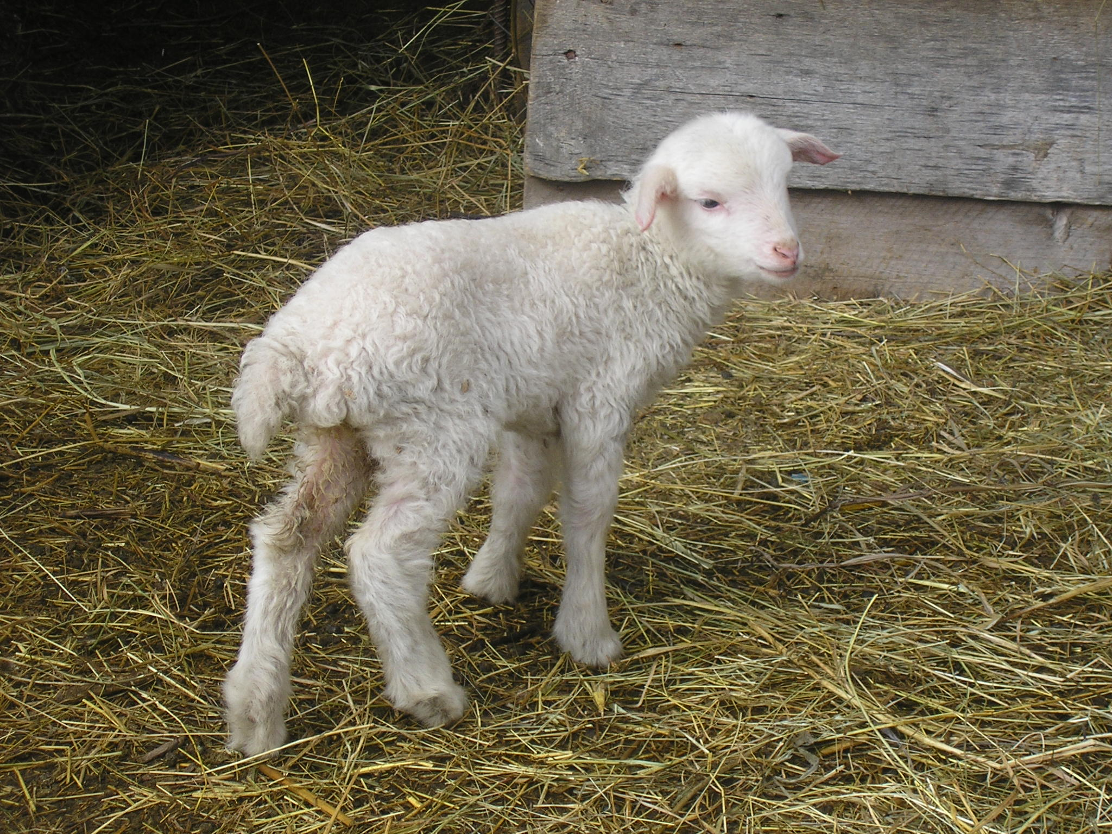
As Jesus said: Feed my lambs.

Slide 31
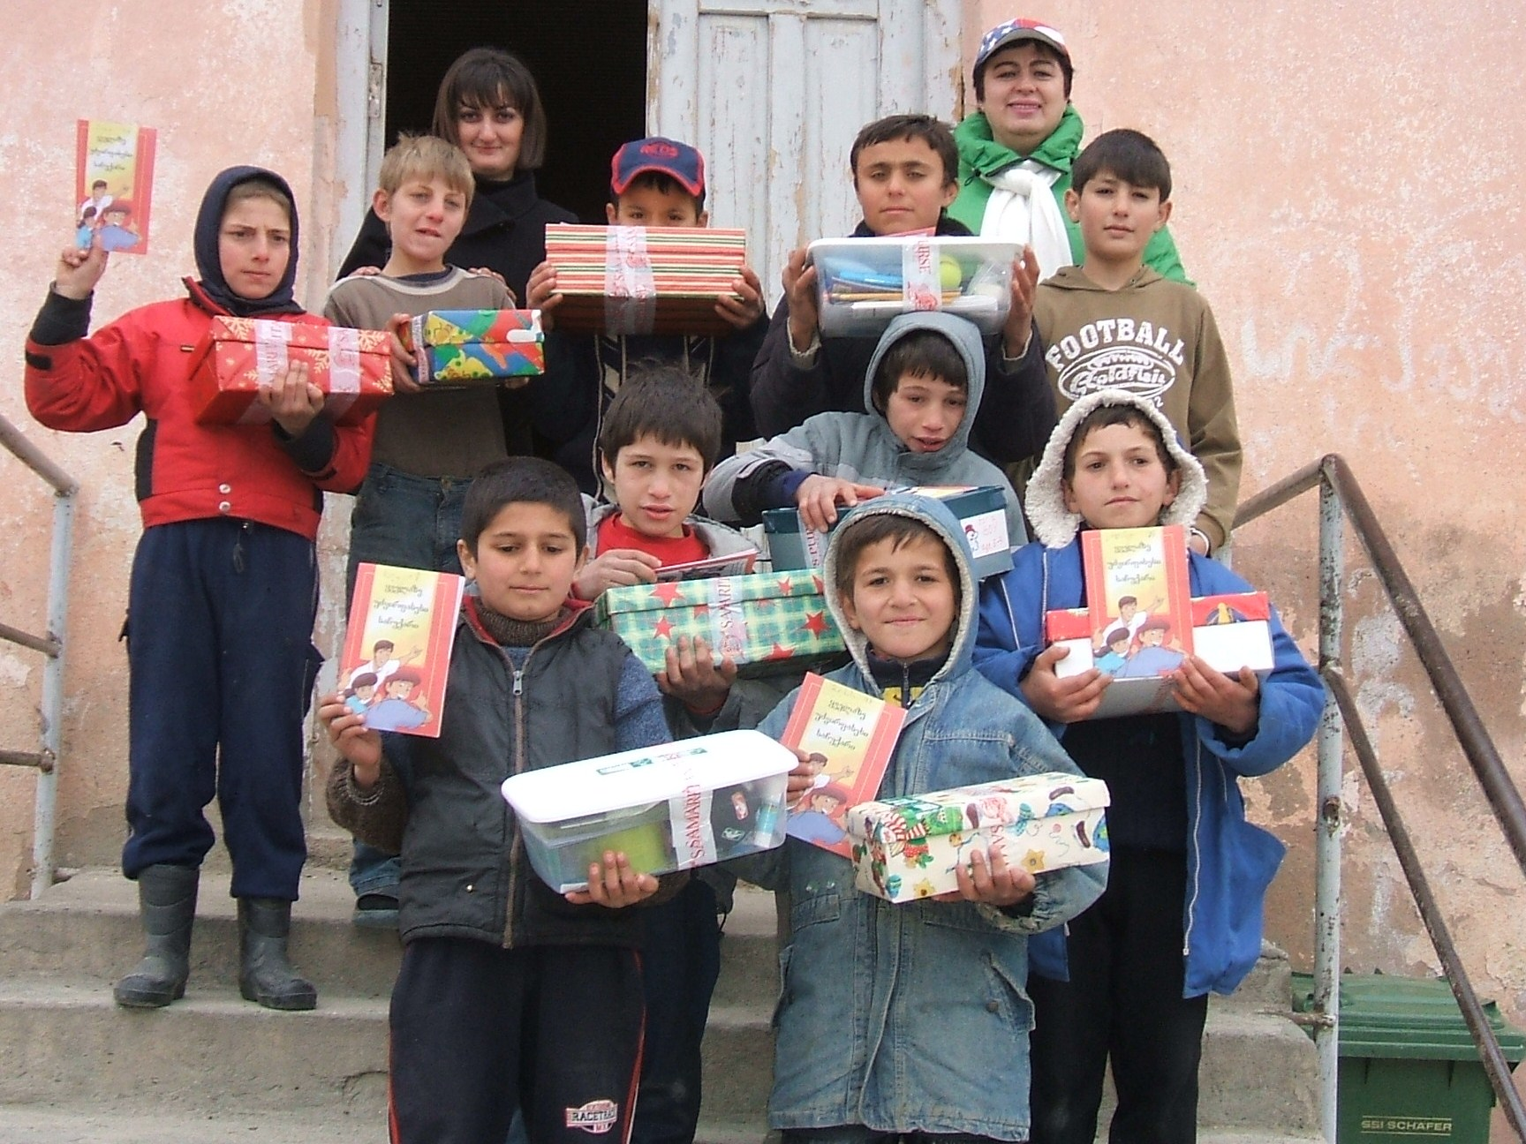
The best gift: the gospel gift

Slide 32
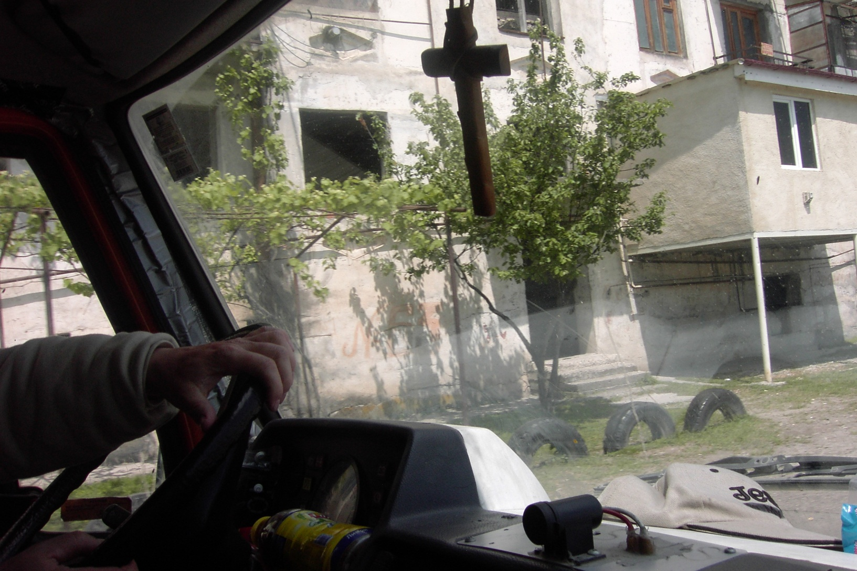
The Cross of Jesus is for all.

Slide 33
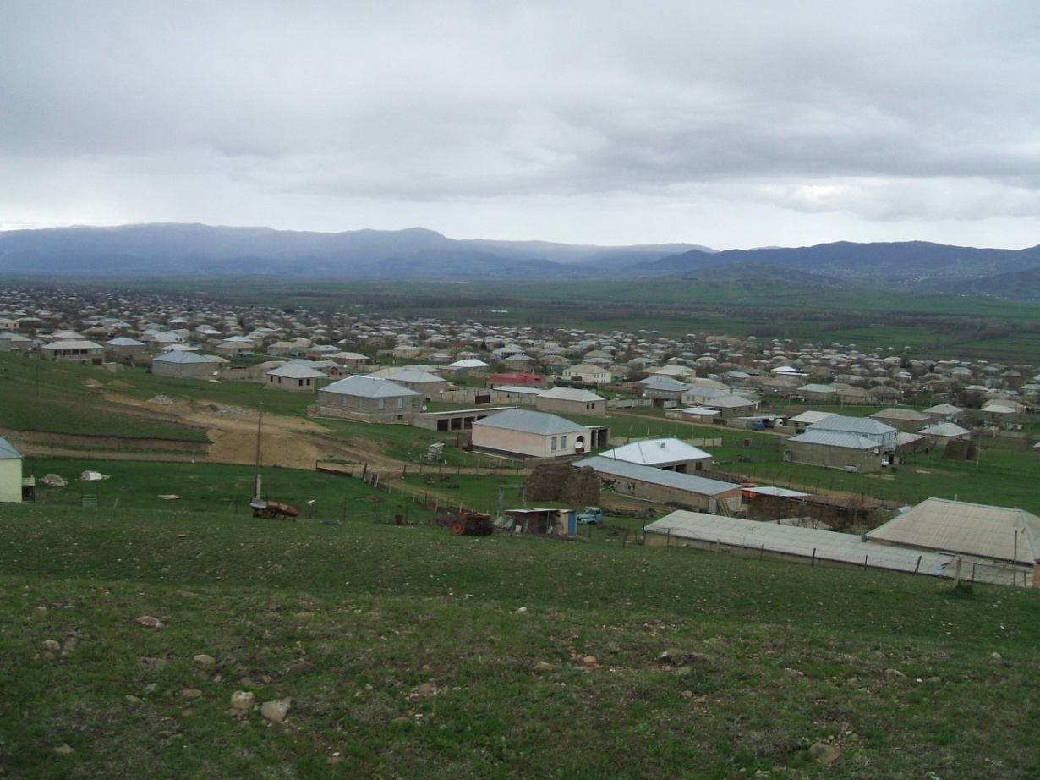
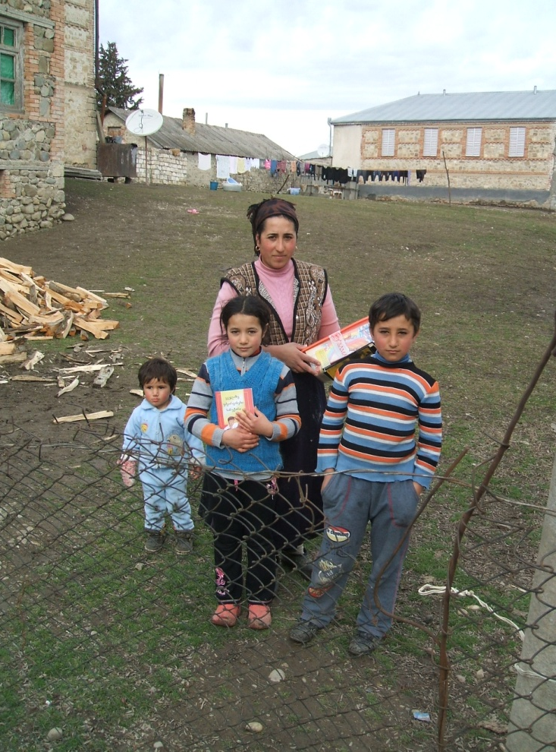
In this village, many single mothers raise their children with lack of gas and piped water. EMSA brought toys and hope.

Slide 34
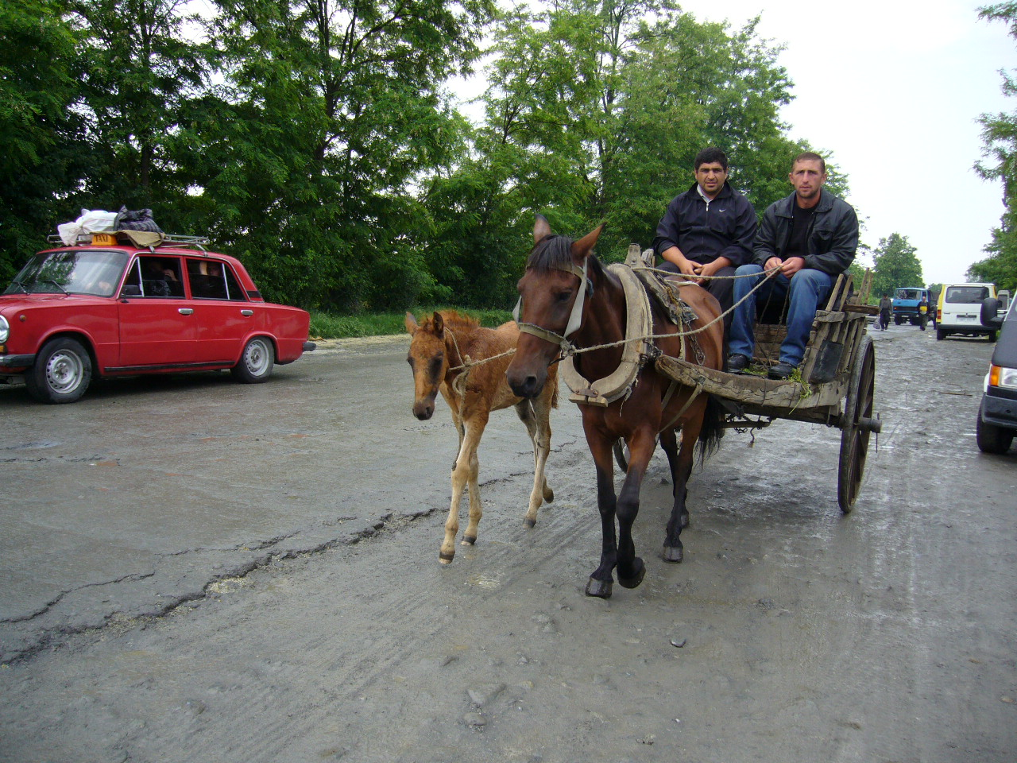
Scene of a market

Slide 35
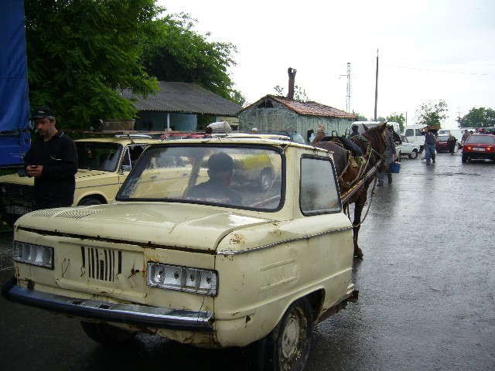
Nothing is impossible in Georgia !

Slide 36
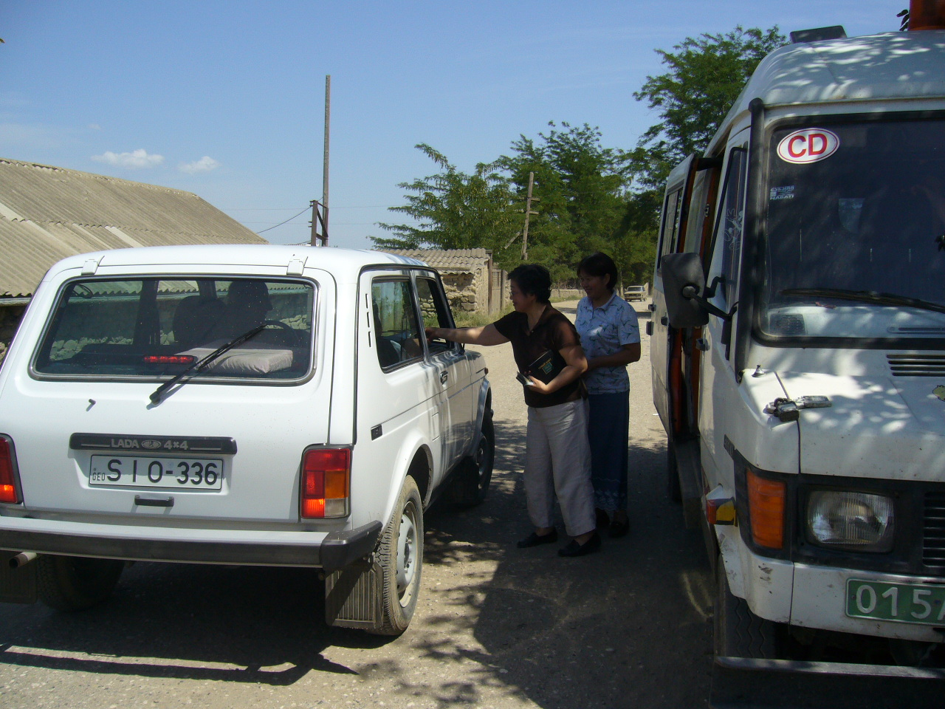

Slide 37
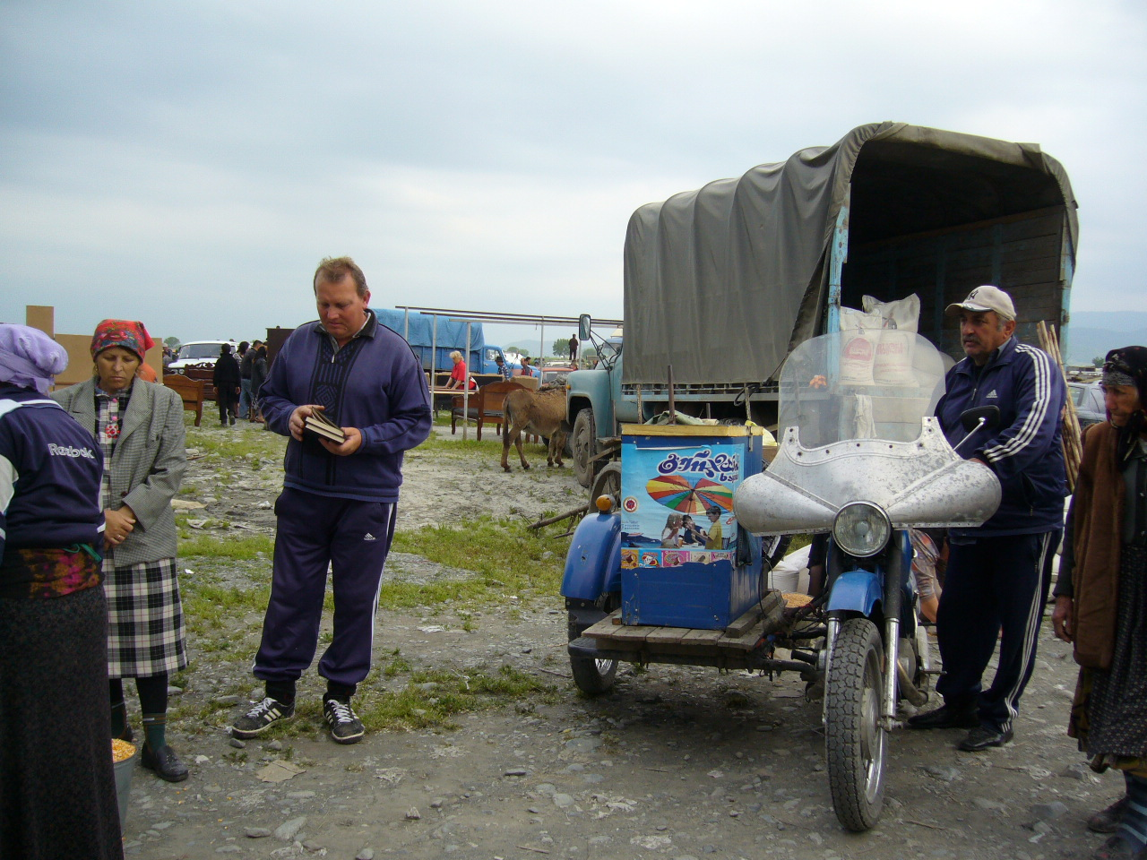
EMSA distributes NTs on markets.

Slide 38
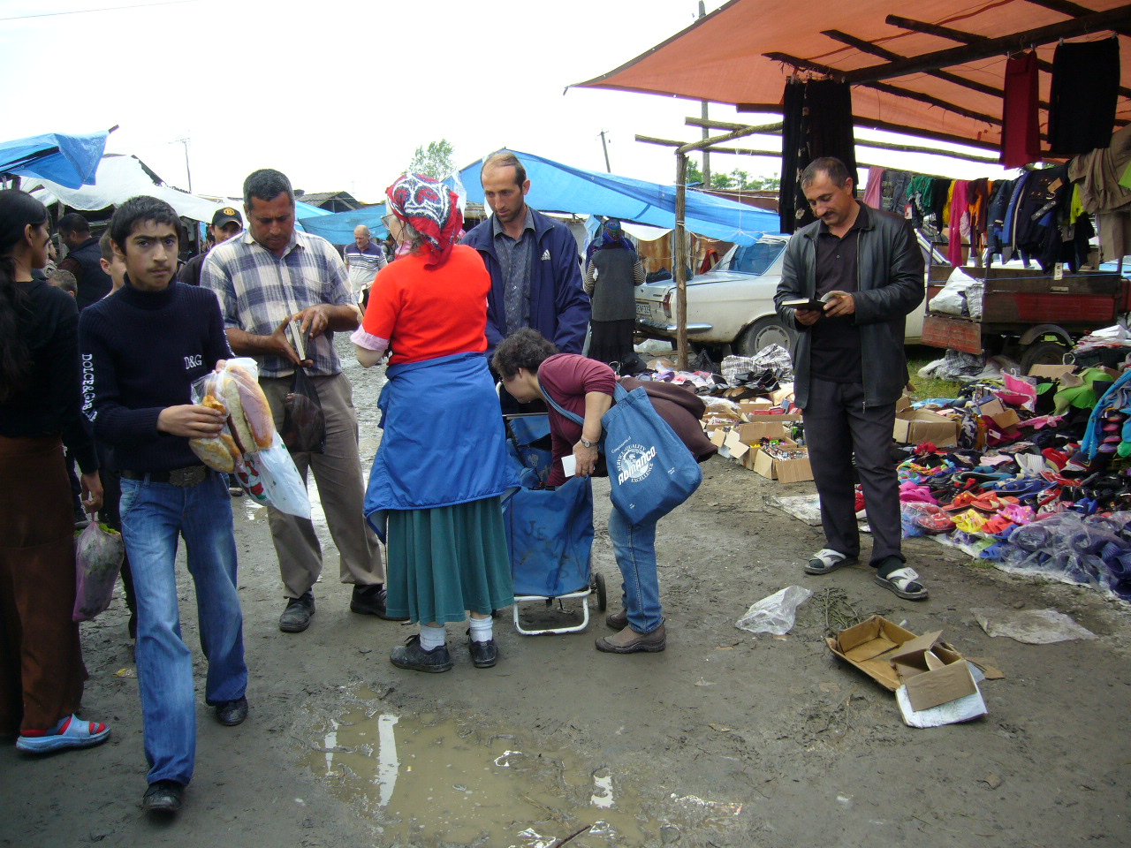
Wherever people are hungry.

Slide 39
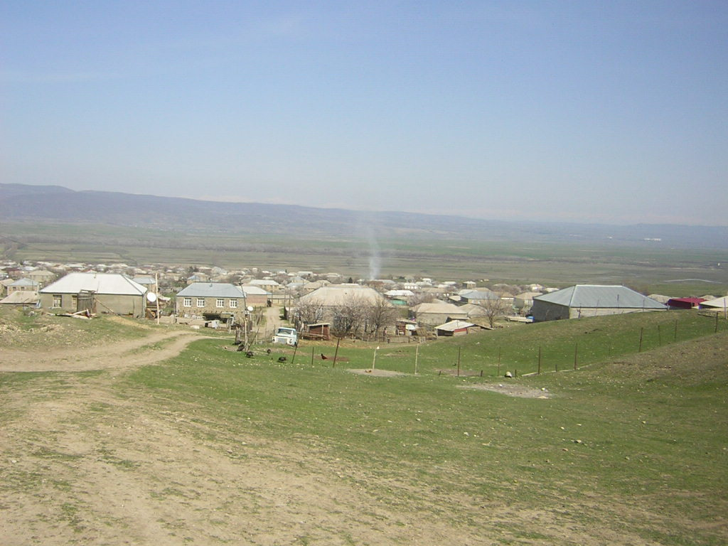
And villages are dry

Slide 40
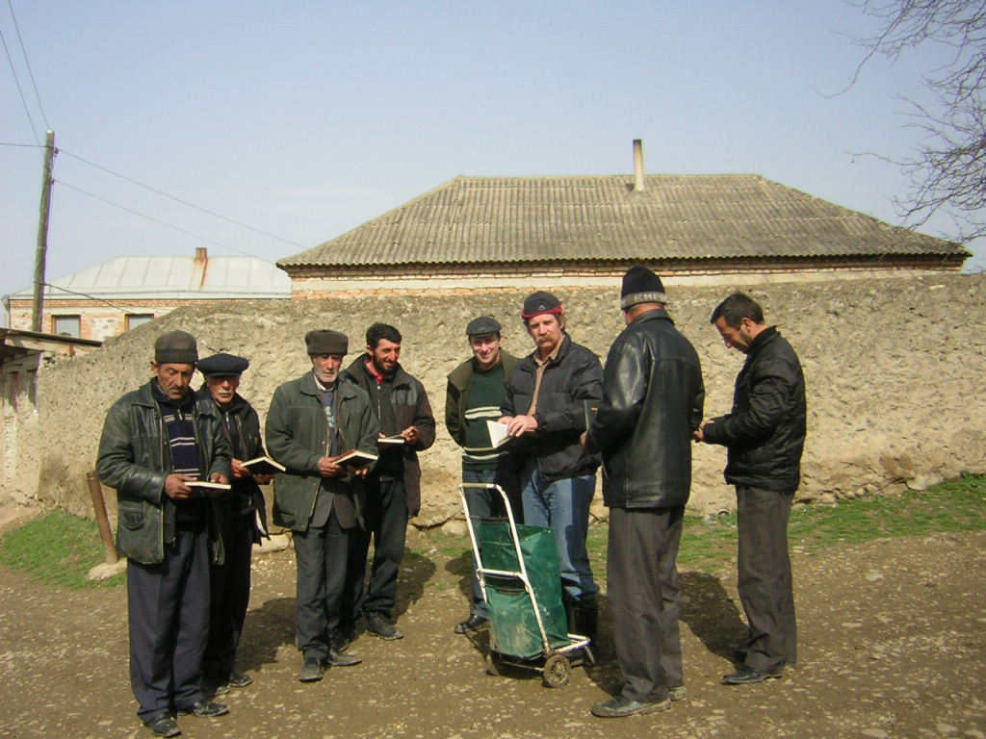
How will they hear the good news if we don’t tell?

Slide 41
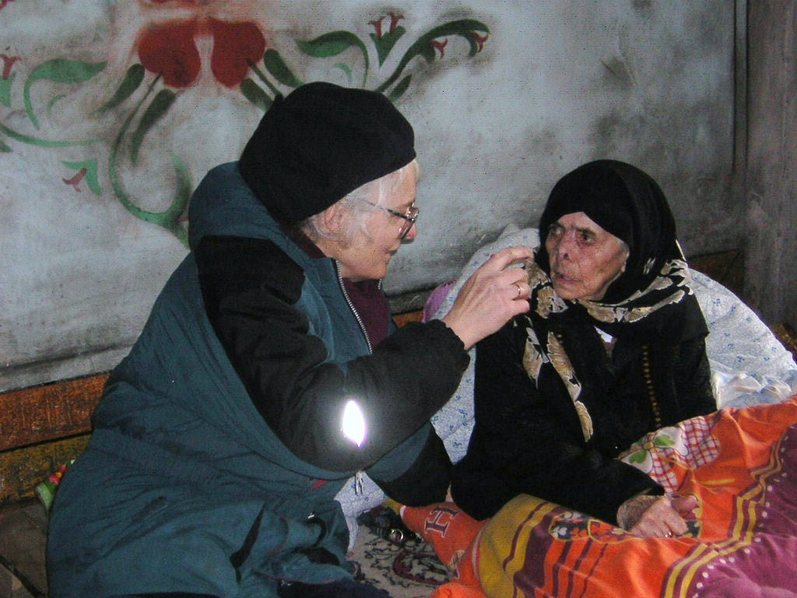
We met a widow over 100 with great interest

Slide 42
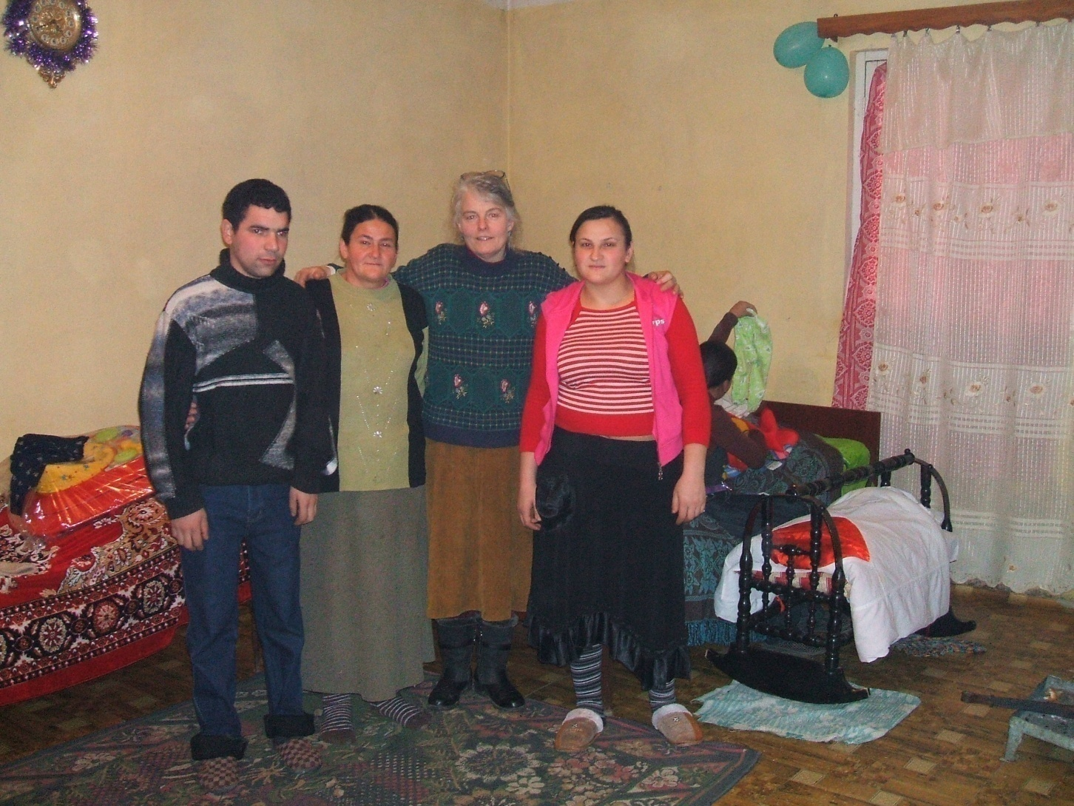
Mother with her family

Slide 43
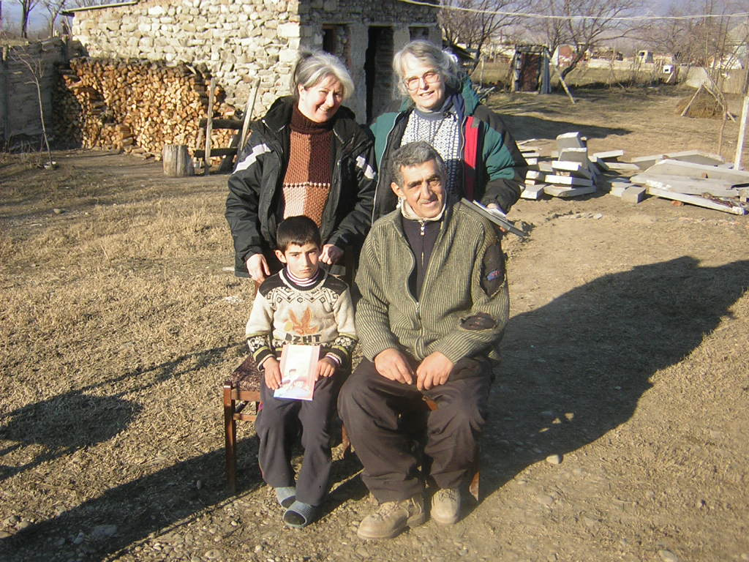
A father received forgiveness and certainty of eternal life

Slide 44
But many women in Georgia can only read Cerylic Azeri.
Many can not afford to buy books.
Georgia opposes import of non orthodox literature.
This language in this form is only printed recently.
Please, pray for good brochures for our Azeri friends.

Slide 45

God is good

Slide 46
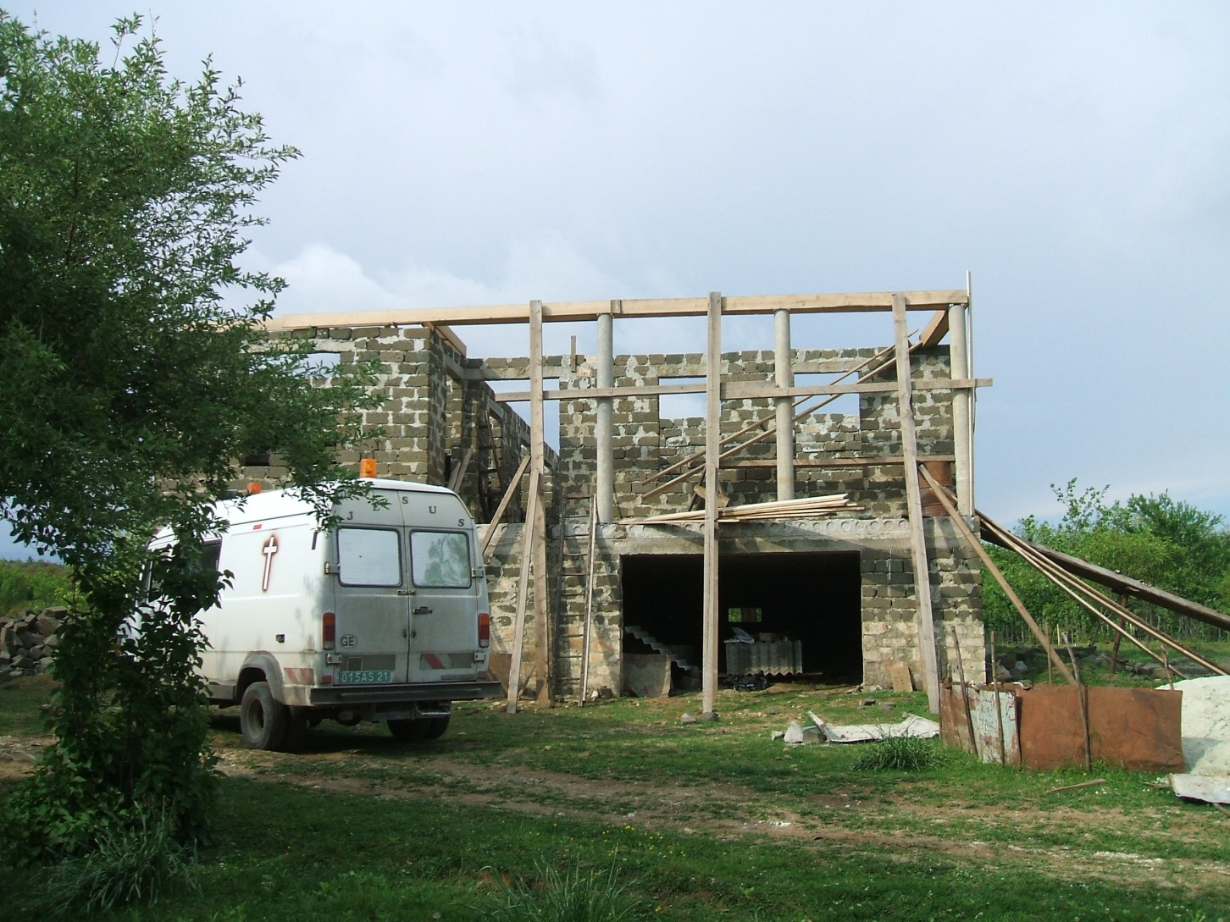
Pastor Gela builds a prayer house

Slide 47
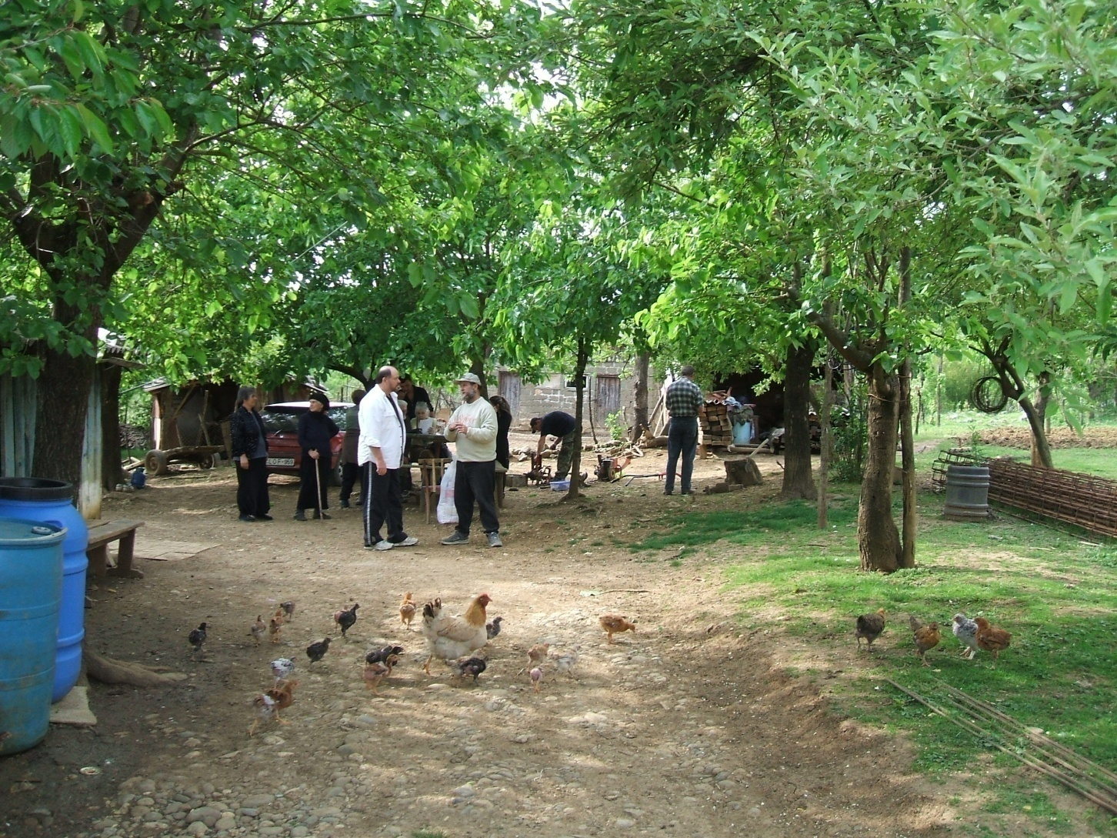
while he himself lives in a wood shed.

Slide 48
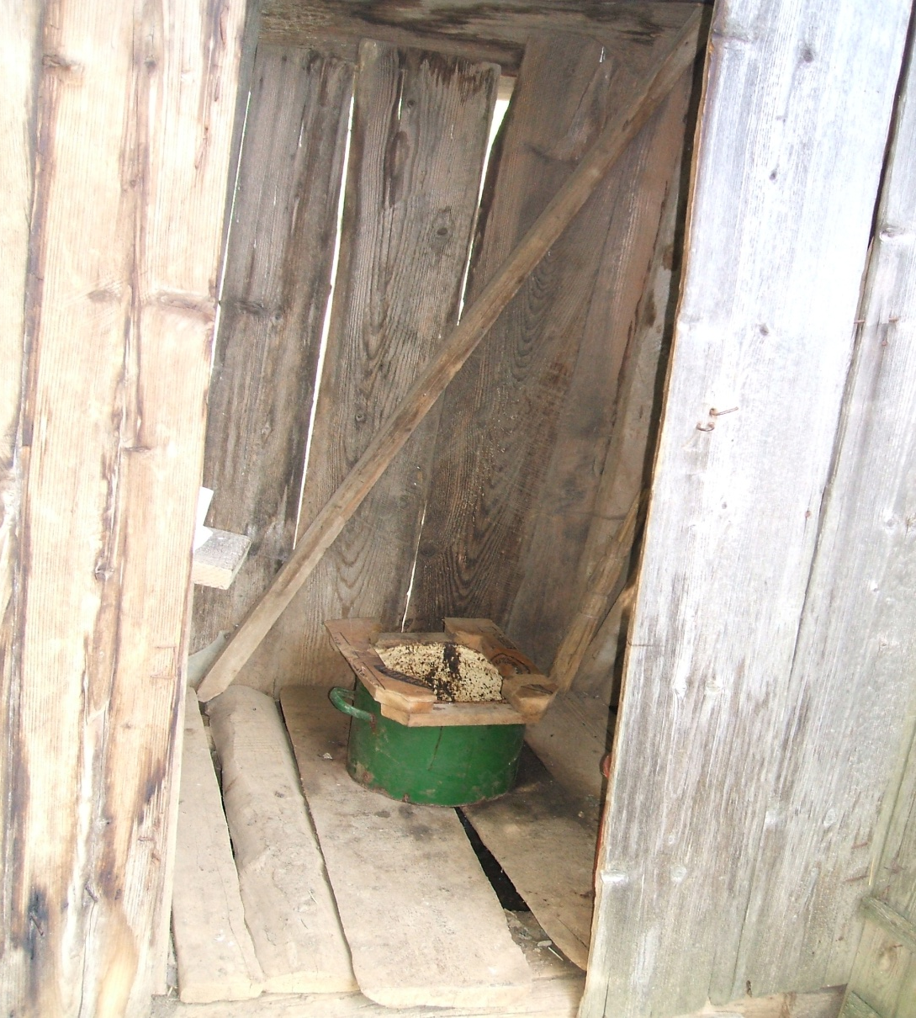
Gela’s out house - bathroom

Slide 49
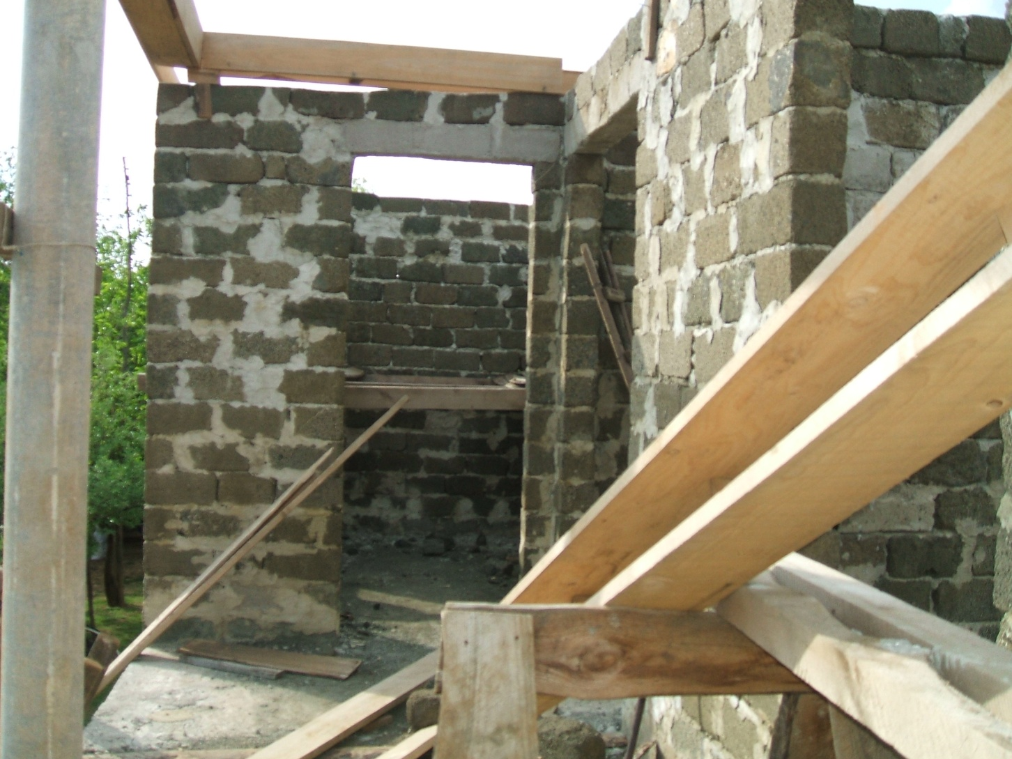
Can he finish the roof before the winter?

Slide 50
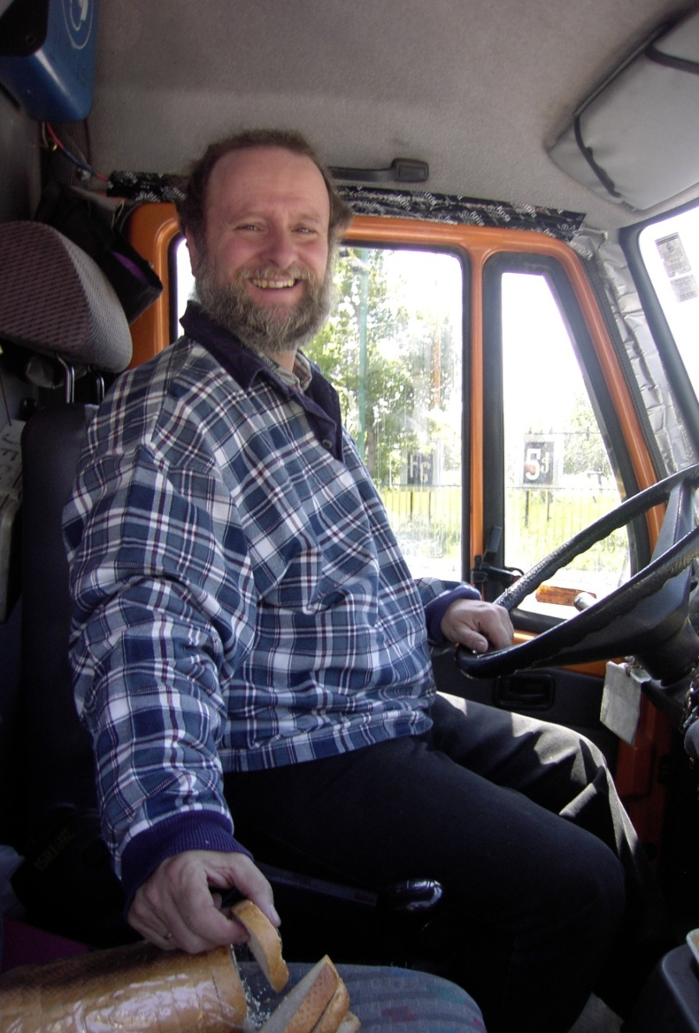
Travel back to Tbilisi with fresh delicious bread from Georgia

Slide 51
Our mission house welcomes
Local Bible schools
Missionary helpers and training
Sunday school teachers
Orphanage volunteer workers

Slide 52
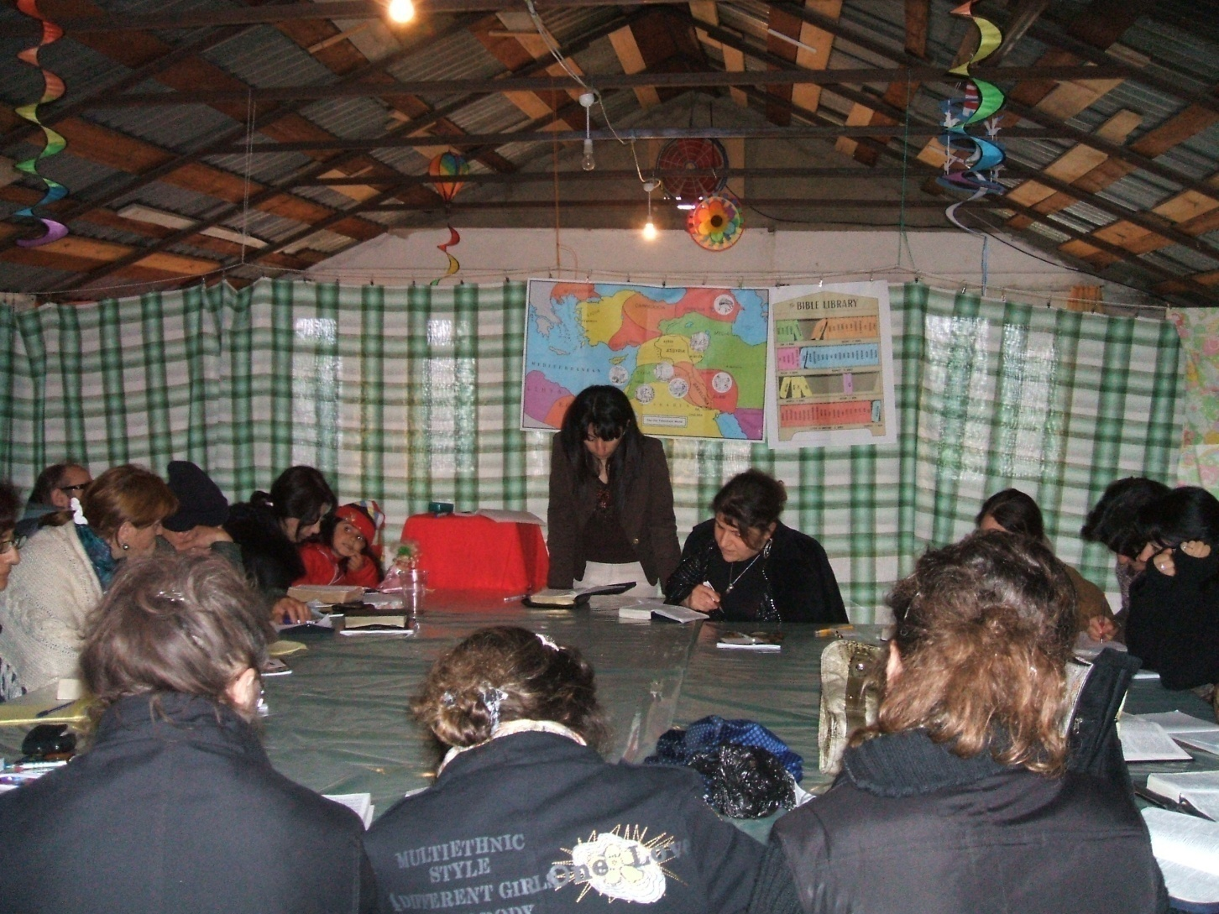
Armenian Bible School

Slide 53
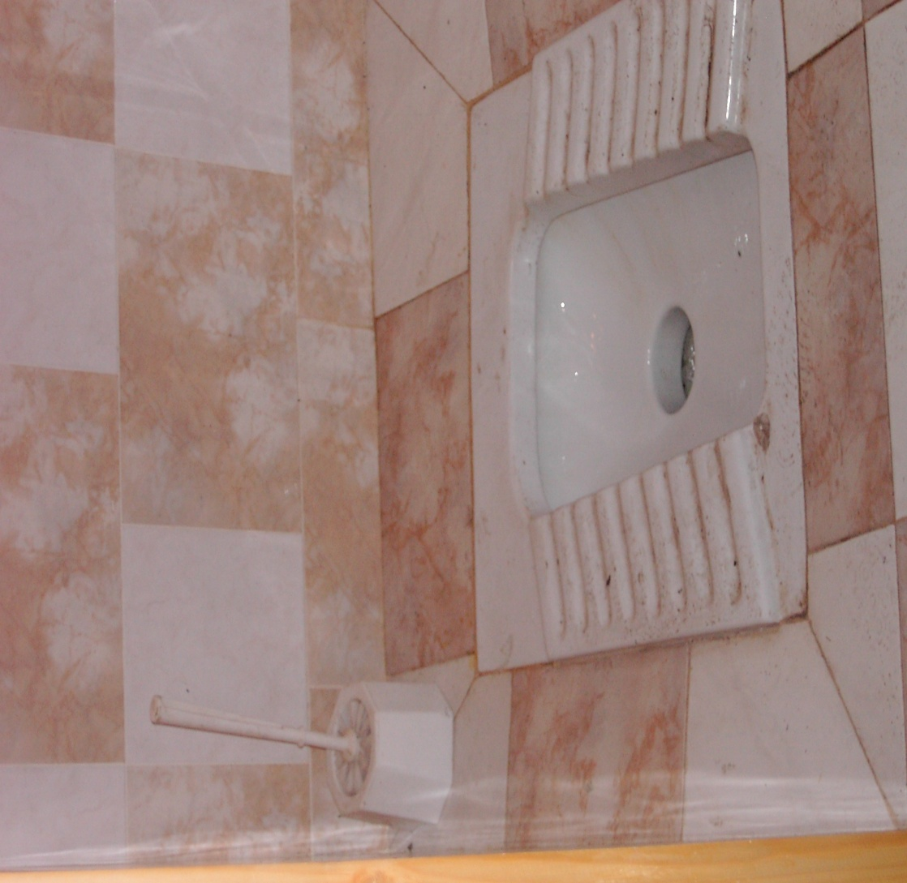
We offer clean facilities.

Slide 54

Kurdish Sunday School

Slide 55

We praise the Lord for what He does.

Slide 56
Contact
Evangelical Mission Society of America
266 Jackson road, Syosset, Long Island NY
516- 921-2788 for more information from Ed.
Email; emsa4@verizon.net
Steve and Sophia Schmalz 2010

